Slide 1
JOURNAL
This presentation will provide directions on how to complete all phases of the “Journal” tab on the AET.

Slide 2
This is your Student Journal Page. From here, you can enter unpaid hours, community service activities, and FFA activities. You can also review entries you have made previously.

Slide 3
Let’s begin by entering unpaid hours. Click on “Time in your AET Experiences (SAEs)”.

Slide 4
You will see the following page. You should complete this page as accurately as possible. Let’s do an example…

Slide 5
Brandon spent 2 hours mowing and weedeating his parents’ lawn on May 18th. He does not receive payment for mowing his parents’ lawn.

Slide 6
For “Date” we would enter “5/18/2015”. We would leave the Category as “Experience-related Activity”.

Slide 7
Brandon has multiple SAEs. For this experience, we would select “Mowing Lawns”, which is the name of the SAE which applies to this scenario.

Slide 8
Next, we would select the appropriate activity. In this case it would be “Managing, producing, harvesting and handling crops.” Remember to click on the green question mark or ask your teacher if you have questions.

Slide 9
Next, enter our hours, which were 2.

Slide 10
Enter a short description of what activity you completed.

Slide 11
Everything else on the page is optional. Pictures can be added at this time or at a later time.

Slide 12
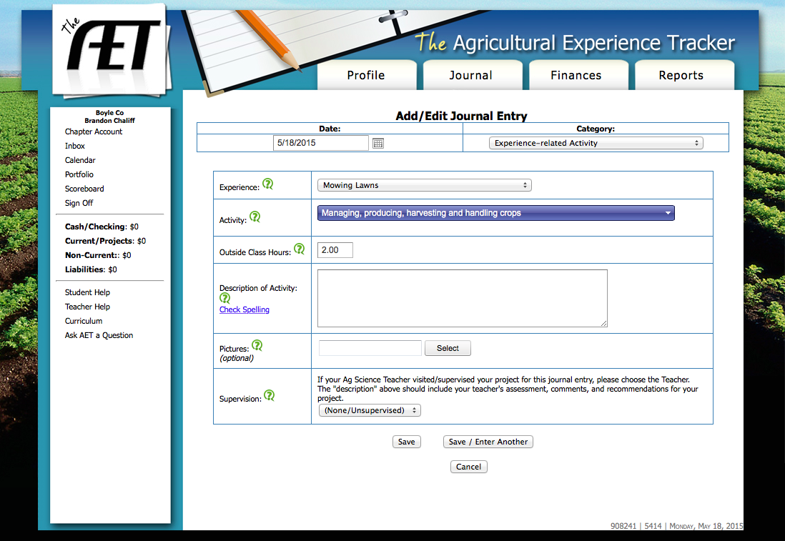
If you are entering records and need to enter another activity, click “Save/Enter Another”. If you are finished entering unpaid activities, click “Save”. Then return to the Journal screen.

Slide 13
Next, click on “Time in your community service activities”.

Slide 14
You will see this screen. Here you can enter community service hours.

Slide 15
Keeping track of community service activities is important because they are required for your State and American Degrees. Here is an example on how to fill it out.

Slide 16
On May 5th, Brandon spent 4 hours helping plant bedding plants outside of First Baptist Church. He did not receive payment for this and it is not related to any of his normal SAE activities.

Slide 17
For “Date” we would enter “5/5/2015”. We would leave the Category as “Community Service Activity”.

Slide 18
Next, enter the group you were working for during your community service, and a short description of what you did.

Slide 19
Finally, enter the hours worked next to “Outside Class”. Click “Save” or “Save/Enter Another”. Then return to the Journal Page.

Slide 20
If you entered FFA offices and committee positions when you set up your profile, you won’t have to do anything on these two items.

Slide 21
Next, you can enter FFA competitions, which will show up on your automatically-generated resume.

Slide 22
This is what the screen looks like when you enter FFA competitions.

Slide 23
Let’s say that Brandon competed in the regional welding competition on April 15th. This activity took 2 hours.

Slide 24
First, enter the date and leave the category as “FFA Competition Activity”

Slide 25
Next, type in the name of the activity and enter the type by scrolling down and selecting the name of the activity. The level is the level in which you competed. (local, regional, state, national)

Slide 26
Then, enter a short description of the activity, and put a value in the “Hours Outside Class” box. These hours will not be factored into any degree or proficiency applications.

Slide 27
Finally, click “Save” if this is your only activity or “Save/Enter Another” if you have further activities to enter. Then return to the Journal page.

Slide 28
The final area of the journal is “Time in other FFA Activities”. This is where you will enter any FFA activities other than competitions or officer/committee positions.

Slide 29
This is the screen for entering other FFA activities.

Slide 30
Now, we will enter that Brandon attended that National FFA Convention in Louisville on October 31st, 2014. This activity took 5 hours.

Slide 31
First, enter the date and leave the category as “Other FFA-related Activity”

Slide 32
Next, type in the name of the activity, select “Convention” for type, and select “National” for level.

Slide 33
Then enter a short description of the activity and the number of outside class hours. These hours will not be calculated on a degree/proficiency application.

Slide 34
Finally click “Save” if you are finished entering FFA activities or “Save/Enter Another” if you have further activities to enter.

Slide 35
This completes the Journal section of the AET. The next power-point will teach you about the first part of the financial tab.

