Slide 1
Finances Part II
This presentation will cover the portions of the AET website dealing with Cash entries, Non-Cash entries
and Paychecks

Slide 2
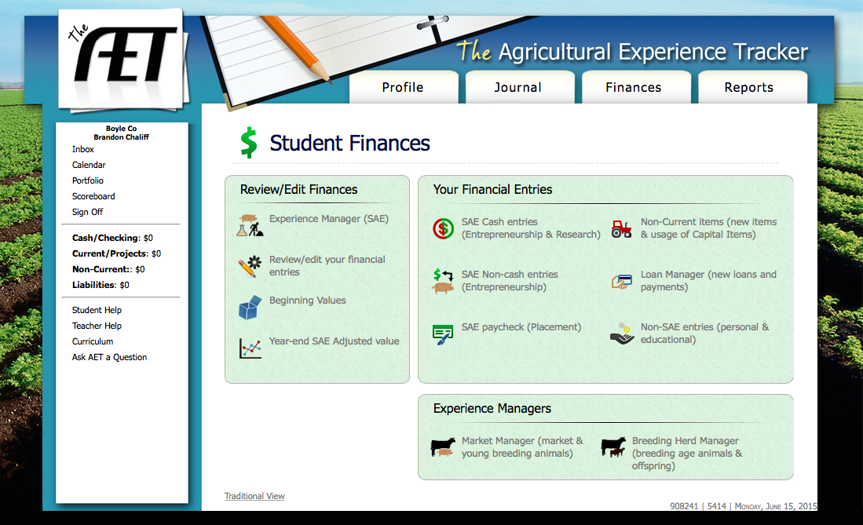
Next, let’s enter some SAE cash entries. These involve income and current expenses which relate to entrepreneurship projects. Never enter anything for a placement project or for non-current items on this link.

Slide 3
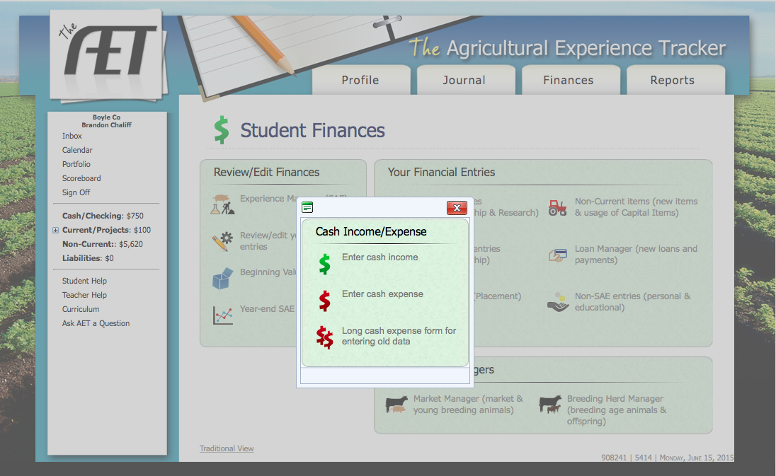
When you click the link you will see these three options. Simply choose between entering income or expenses. We will do examples for each.

Slide 4
Income examples- We will enter all these on the same date.
Brandon sold $850 in banana peppers at the farmers market from 6/1-6/15.
Brandon showed a market steer at the county fair and received $30 in premium money.
Brandon sold a steer at the stockyard for $750.

Slide 5
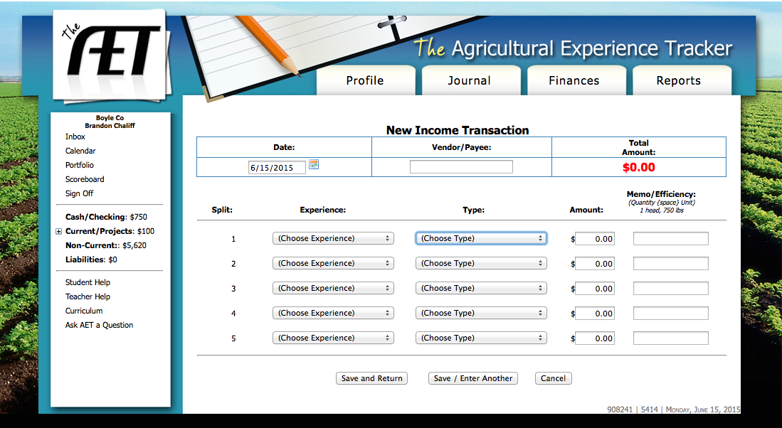
This is what the Income Transaction page looks like.

Slide 6
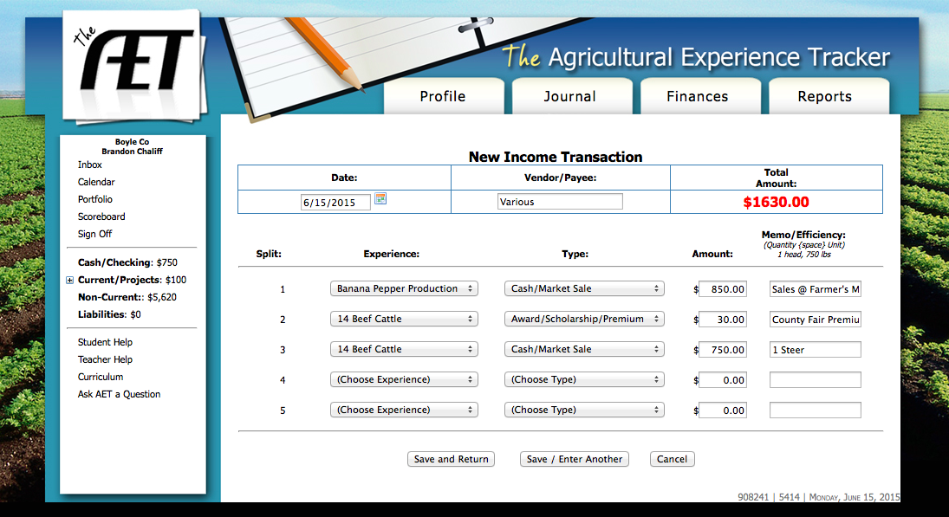
This is what it looks like after we we enter our information for Brandon.

Slide 7
The date can just be the date you enter the information. As long as you are enrolled in an Ag. class on this date your information will be on any applications.

Slide 8
The Vendor/Payee is who purchased the items from you. If you are entering items from multiple buyers, you can just put “various”. This information will not show up on any applications.

Slide 9
Under “Experience” select the appropriate entrepreneurship project for the item you are entering.

Slide 10
Under “Type” select from the drop-down menu the appropriate type of income. 99% of the time, this will be “Cash/Market Sale”

Slide 11
Side Note: If you have a business where you sell services (i.e. mowing lawns) you will select “Cash/Market Sale” when you enter payments from customers.

Slide 12
Under “Amount” type the amount of money you received for each item.

Slide 13
Under “Memo” you can put any notes you may need. This information will not be pulled for applications. You might put how many lbs., bushels, etc. you sold so you can keep track of the efficiency of your project.

Slide 14
At this point, you can click “Save” or “Save/Enter Another”. Lets do some expense examples.

Slide 15
Expense Examples
Brandon purchased 500 lbs. of 20-20-20 fertilizer for his banana pepper field for $300.
Brandon payed his 2 cousins $100 to help him transplant banana peppers.
Brandon spent $300 on ground feed for his cattle.
Brandon bought a new table for his farmer’s market tent (to sell peppers) for $50.
Brandon bought 5 feeder steers for $750 apiece.

Slide 16
Remember to return here to get started!

Slide 17
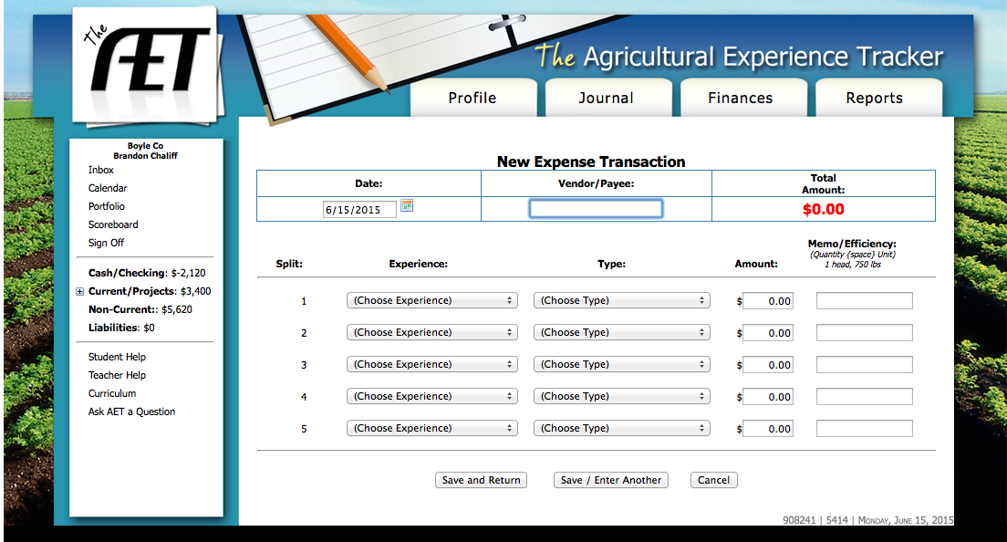
The Expense Transaction page looks very similar to the Income page.

Slide 18
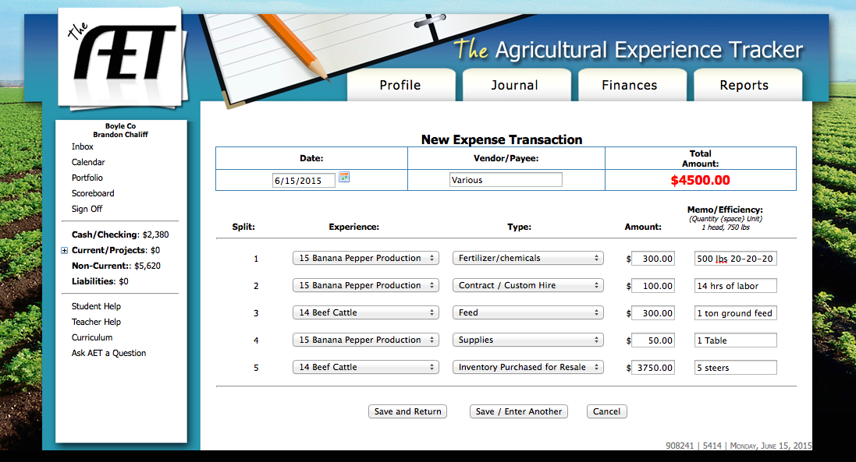
This is what our information will look like after we enter it.

Slide 19
This time, under “Type” we have several options to choose from. Make sure your choose the option that most closely fits the item you have purchased.

Slide 20
Notes on the expense page
Other than the “Type” everything else is the same as the “Income Transaction” page.
Under “Amount” you put the cost of the items rather than the amount you made.
You can still put “various” for the vendor if desired, or you can enter each individual business you purchased items from.
Be sure to hit “Save” or “Save/Enter Another”.

Slide 21
Next, let’s enter non-cash entries for entrepreneurship projects. This involves things like labor exchange, barter, etc.
We will do an example for each category under this link.

Slide 22
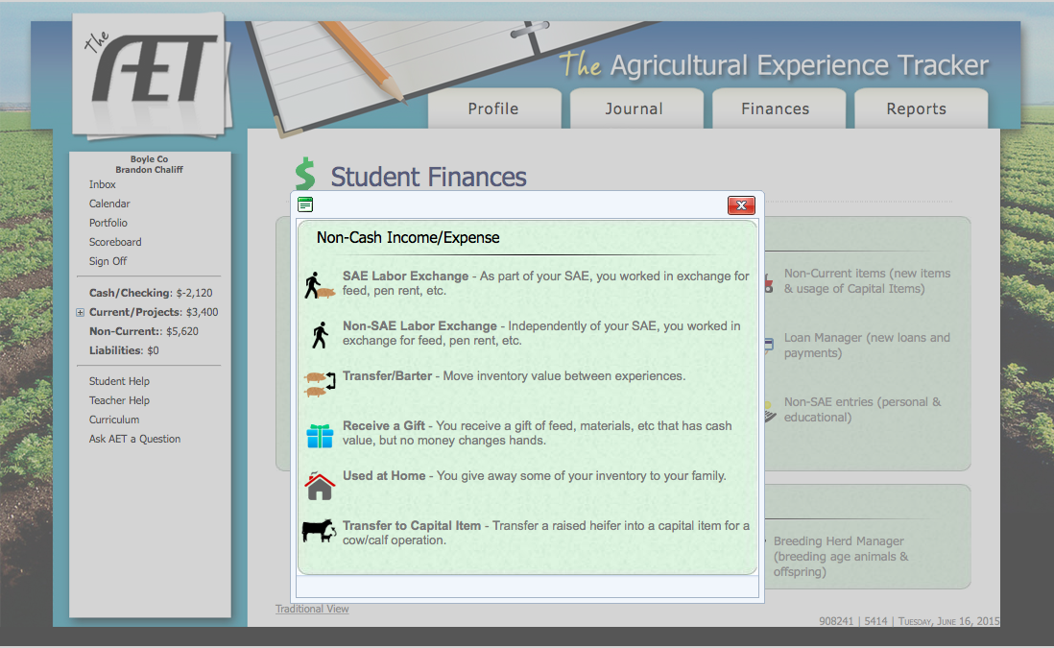
This is what the “SAE Non-Cash Entries” link will send you to. Let’s do a few examples with Brandon.

Slide 23
Non-Cash Example #1
Brandon works for his father on their farm. Instead of receiving cash payment, Brandon’s father lets him have a portion of the farm to raise his beef cattle. Together, Brandon and his father estimate that this land rental is worth $1000 per year.

Slide 24
This is a perfect example of an SAE labor exchange.

Slide 25
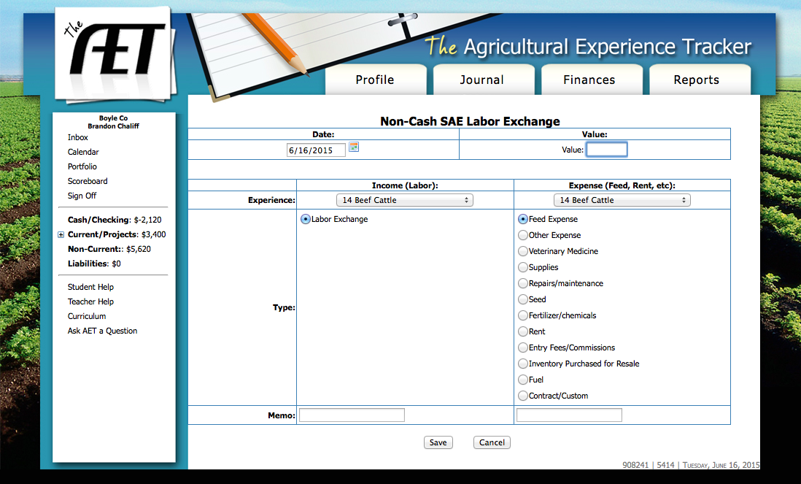
The SAE Labor Exchange will bring you to this page.

Slide 26

Here’s how Brandon would fill this out. First, if he wants to enter an item like this once per year, the date doesn’t really matter. When entering your own records, you can enter a labor exchange as often as you’d like.

Slide 27
For “Value”, we would enter the amount received for the services provided.

Slide 28
For Income, we need to select the project which you labor most closely fits under. For this example, it would be Beef Cattle.

Slide 29
For Expense, we need to select the project that is gaining income from our labor, once again this would be beef cattle in this example.

Slide 30
In the list under “Expense” we need to select the type of item we are receiving. In this case it would be rent because Brandon is utilizing land he doesn’t own himself.

Slide 31
Finally, you can put an optional memo to help you keep track of your entries. Be sure to hit save!

Slide 32
Non-Cash Example #2
Brandon decided to use some excess fertilizer from his banana pepper project to fertilize his cattle pasture. He estimates the value of this fertilizer at $150.

Slide 33
This would be an example of a transfer/barter.

Slide 34
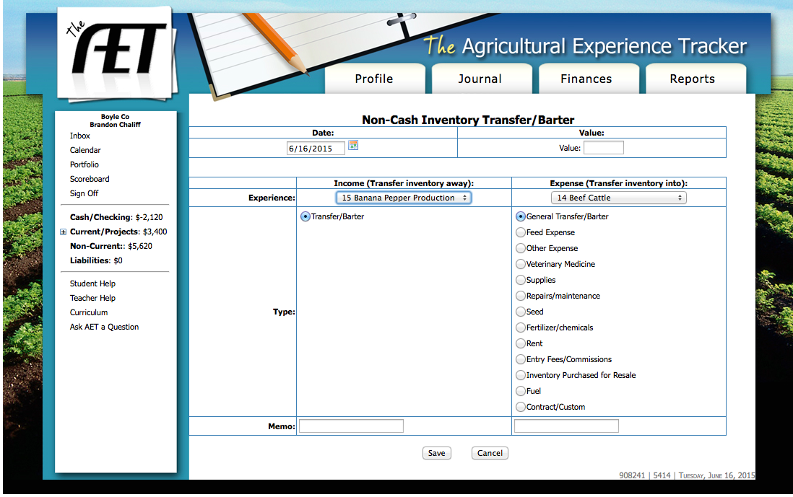
This is the Transfer/Barter Page.

Slide 35

This is what our completed Transfer/Barter page would look like.

Slide 36
The value would represent the worth of the item being transferred.

Slide 37
On “Income” we select the project that is losing inventory.

Slide 38
On “Expense” we select the project that is gaining inventory.

Slide 39
Under “Expense” we need to select the type of item being transferred.

Slide 40
And we can also make a memo for personal use.
Don’t forget to click save!

Slide 41
Non-Cash Example #3
Brandon’s grandfather decided to give all his grandchildren a calf. Brandon selected a steer estimated to be worth $750.

Slide 42
This would be an example of “Receive a gift”.

Slide 43
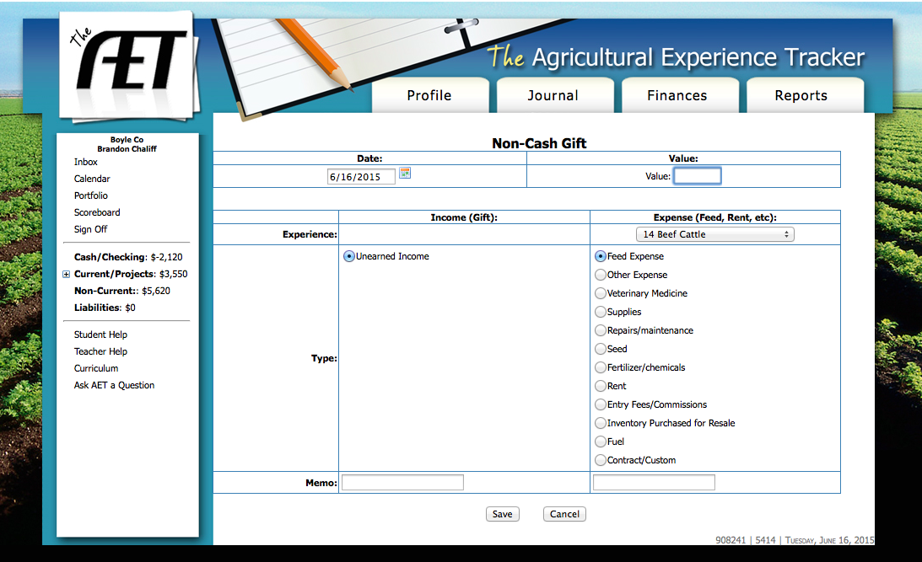
This is what the Non-Cash Gift page will look like.

Slide 44

And this is what our page looks like after we fill it out.

Slide 45
Our value will be the worth of the gift.

Slide 46
For “Expense” we will select the project that is benefiting from the gift.

Slide 47
Under “Expense” we will select the type of gift we received. In this case, Brandon most likely plans to sell his steer, so we would select “Inventory Purchased for Resale”.

Slide 48
We can also add a memo. Don’t Forget to click Save!

Slide 49
Non-Cash Example #4
Brandon’s family decided to have a cookout and Brandon made fried Banana Peppers to share with everyone. He estimated the value of the peppers he used to be $10.

Slide 50
This would be an example of items “Used at Home”.

Slide 51
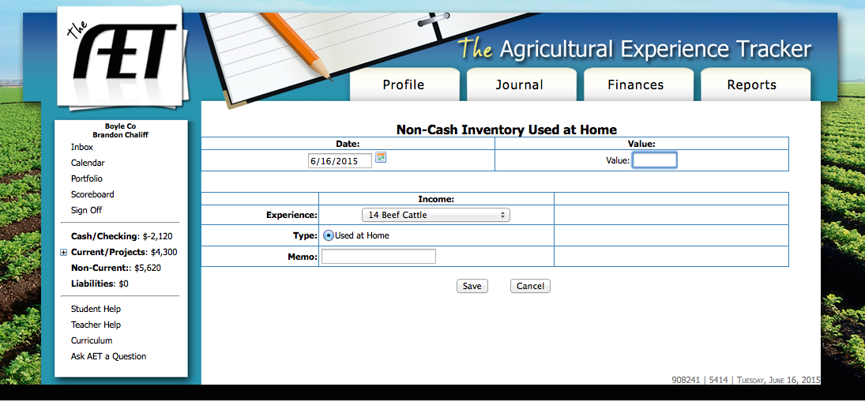
Here is what the “Used at Home” page looks like.

Slide 52
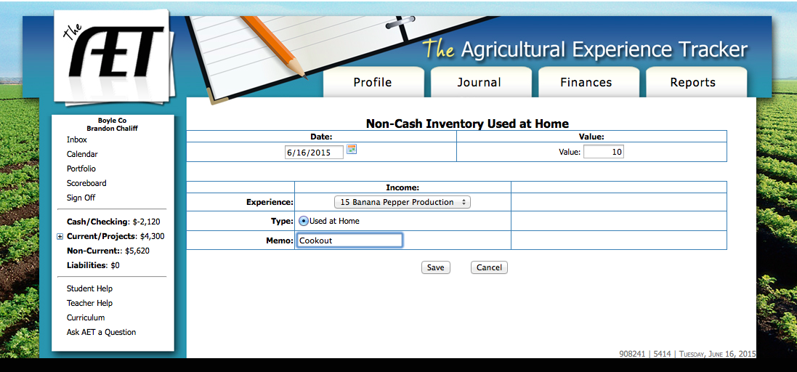
And here it is with our information completed.

Slide 53
The value is the worth of the products we used.

Slide 54
The Experience is the SAE from which we used the products.

Slide 55
And, as usual, we can make a memo. Don’t forget to click Save!

Slide 56
Non-Cash Example #5
Brandon’s heifer had a calf on 6/16/15. She is now a cow with an estimated value of $1200.

Slide 57
Here we would “Transfer to Capital Item”.

Slide 58
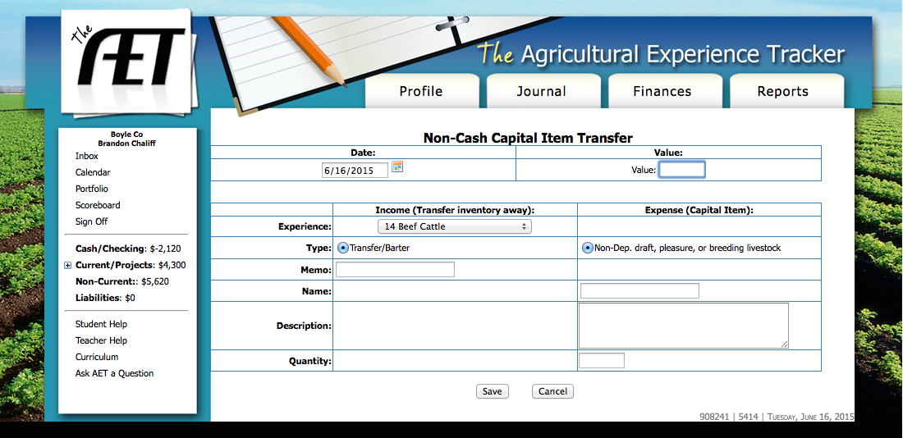
This is what the Capital Item Transfer Page looks like.

Slide 59
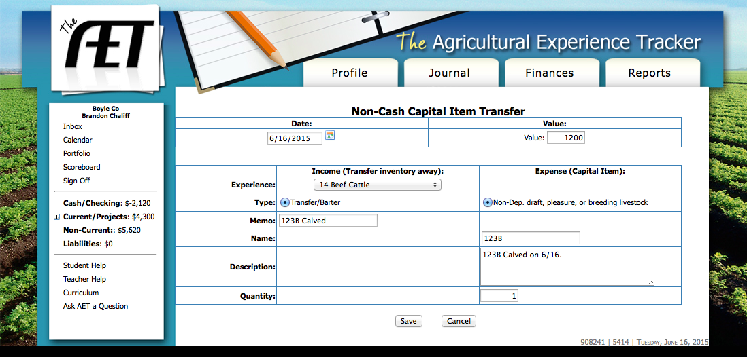
And here is what our page looks like after we fill it out.

Slide 60
The value is the current worth of the item we are transferring to capital.

Slide 61
The “Experience” is the project involved in the transfer.

Slide 62
You can also put pertinent information in the “Memo”, “Name”, and “Description”.

Slide 63
For “Quantity” put the number of items being transferred. Then click save!

Slide 64
This completes the Non-Cash portion of the Finance tab. Let’s look at how to enter a paycheck!

Slide 65
Example
Brandon worked at Albright Feed Mill for 25 hours between 6/1 and 6/16. He earned $8.00/hr. during this time. His paystubs had a total of $48.25 in tax deductions during this time and he had no expenses related to his project.

Slide 66
In this instance, we need to do an “SAE Paycheck”. This link is only used for paid placement projects. Never enter anything else in this link.

Slide 67
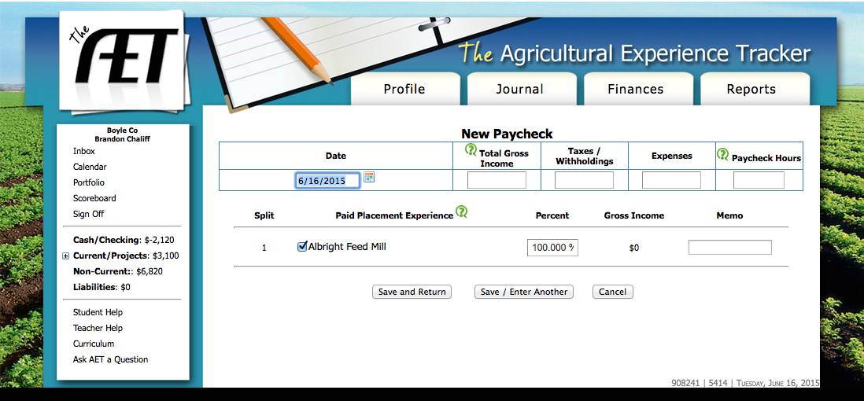
This is what the SAE Paycheck page will look like.

Slide 68
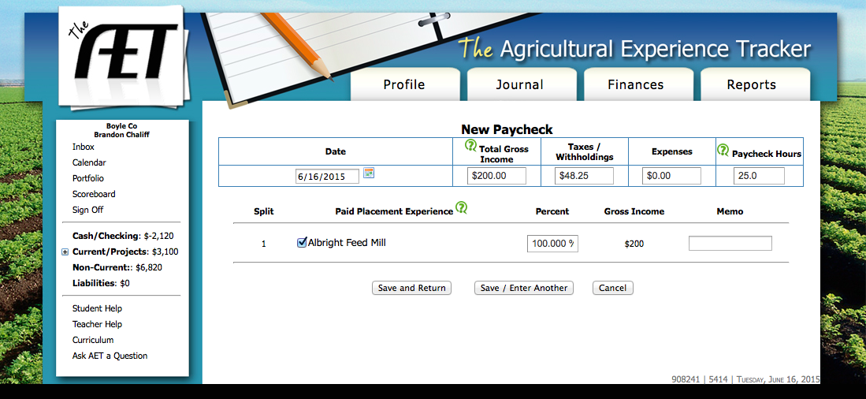
And here we have our Paycheck page completely filled out.

Slide 69
“Total Gross Income” is the total amount we made during the pay period ($8/hr x 25 hr = $200)

Slide 70
“Taxes/Withholdings” is the amount deducted from our paycheck.

Slide 71
Only put expenses if you spent part of your earnings on something related solely to your paid placement project.

Slide 72
“Paycheck Hours” is the amount of time we worked during the pay period.

Slide 73
There should hardly ever be a reason to change the “Percent” from anything other than 100. Ask your Ag. Teacher if you are not sure. Don’t forget to save!

