Slide 1
Livestock Management
This presentation will walk you through the basics of the Market Animal Manager and Breeding Animal Manager feature on the AET.

Slide 2
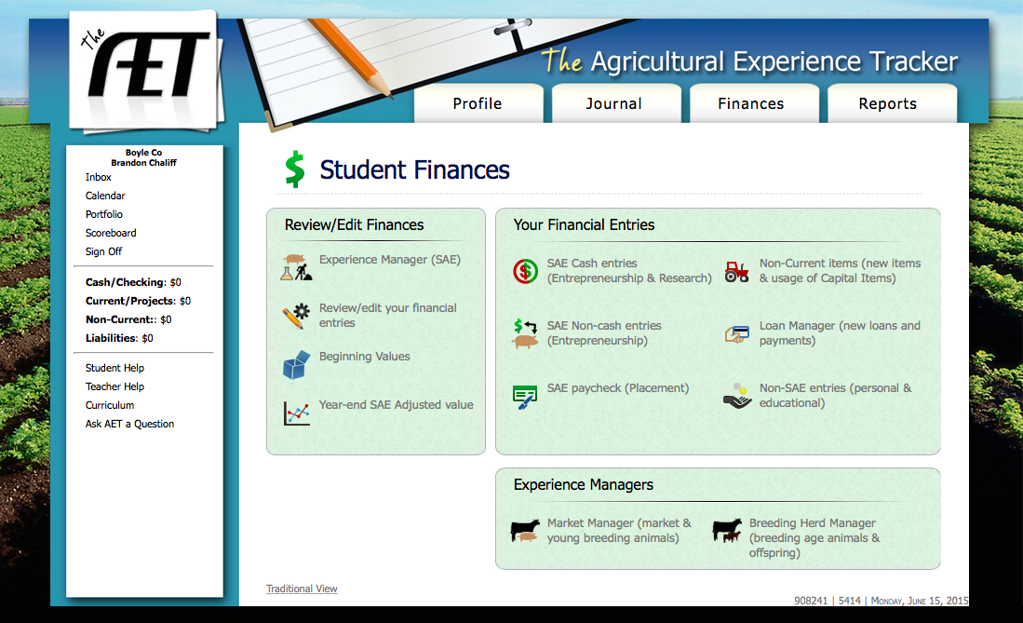
The bottom of the finance page features “Experience Managers” with these tools, you can manage both market and breeding animals. Let’s see a few examples of how you can use these tools.

Slide 3
Example #1
On July 27th, Brandon purchased two 350 pound steers and one 350 pound heifer that he plans to raise and sell at a later date. He paid Blackwater Farms $500 apiece for the steers.

Slide 4
For this example, we would begin by clicking on “Market Manager” since steers are considered market animals.

Slide 5
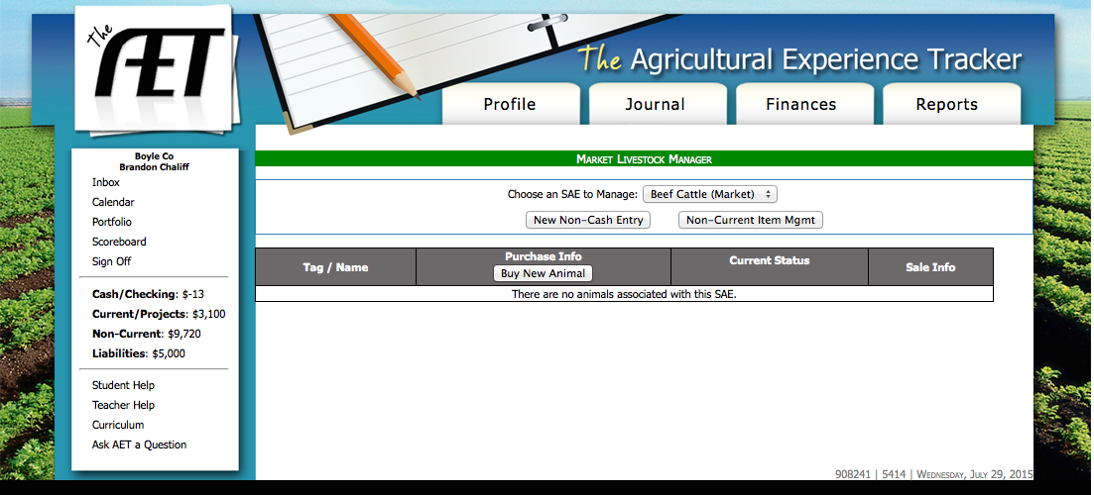
This is the “Market Manager” screen. In this example, we would click on “Buy New Animal”.

Slide 6
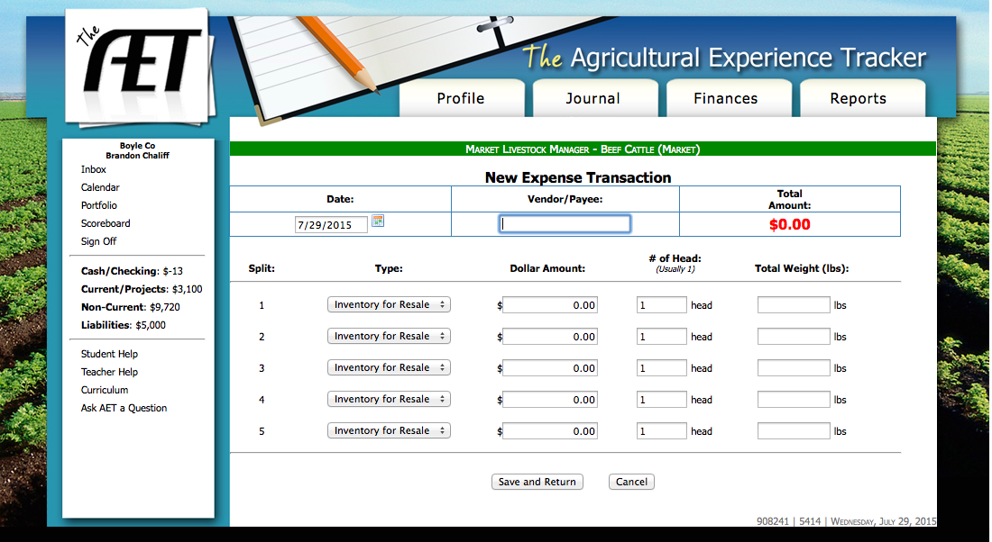
This is the page for entering market purchases. It will be much easier for management purposes if we enter each animal on an individual line.

Slide 7

This is our page after filling it out. For “Date”, we enter the date of purchase and on “Vendor/Payee” we enter who we made the purchase from.

Slide 8
The “Type” will always be “Inventory for Resale” on this page. “Dollar Amount” is how much we paid for each animal. “# of Head” will need to be “1”. And finally, the “Total Weight” is the weight of each individual animal. Click save when you are finished.

Slide 9
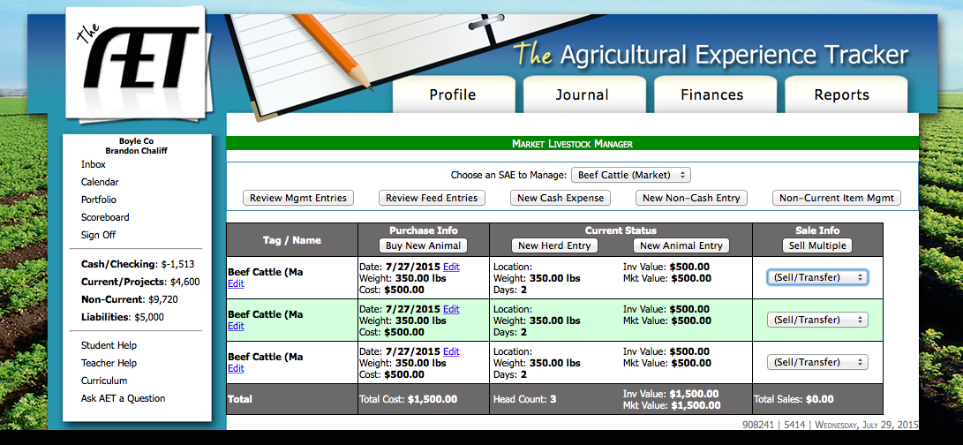
The Market Manager page will now look like this.

Slide 10
You can now manage the records of these 3 animals individually. Let’s look at a couple of examples.

Slide 11
Steer #1 is struck by lightning and killed.
Brandon decides to have Steer #2 slaughtered and cut into freezer beef for his family. He determines the market value of the animal at time of death to be $505.
Brandon changes his mind about the heifer and decides to have her bred.

Slide 12
We will make all this changes in the “Sale Info” column by making the appropriate selection from the drop down box.

Slide 13
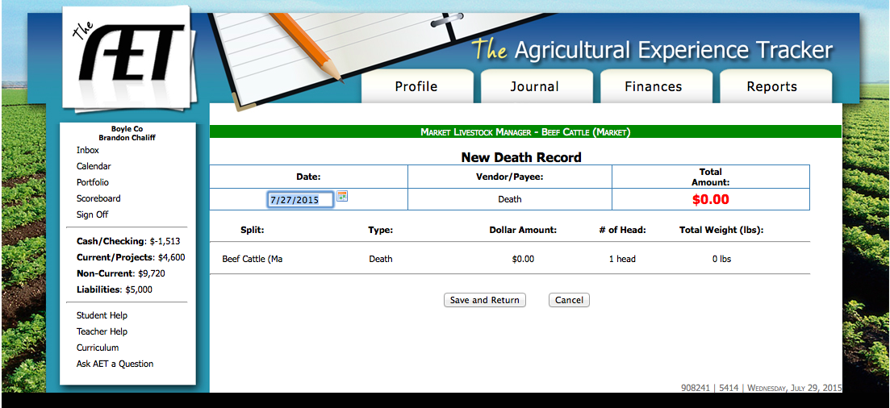
For the first steer, selecting “Death/Loss” from the drop down box will take you to this page. Simply click “Save and Return”

Slide 14
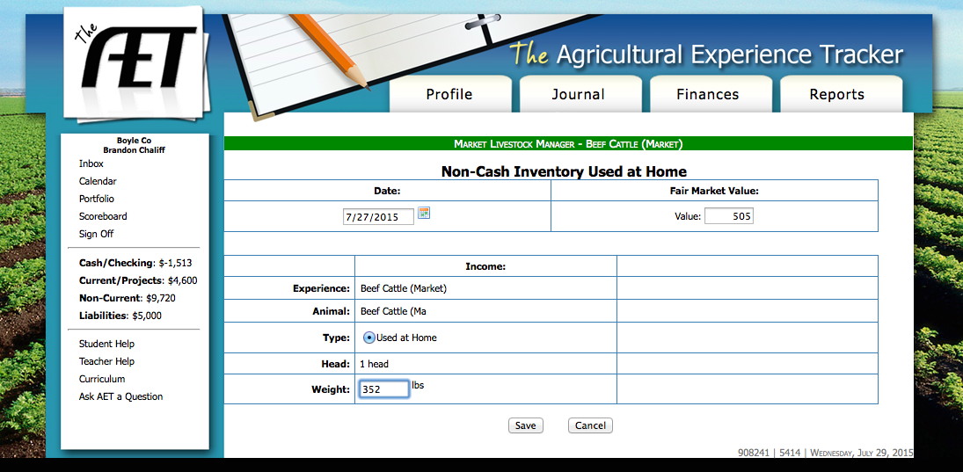
For the second steer, choosing “Used at Home” from the drop down box will take you to this page. Here you will enter the “Fair Market Value” as well as the final weight of the animal. After filling in the information, click save.

Slide 15
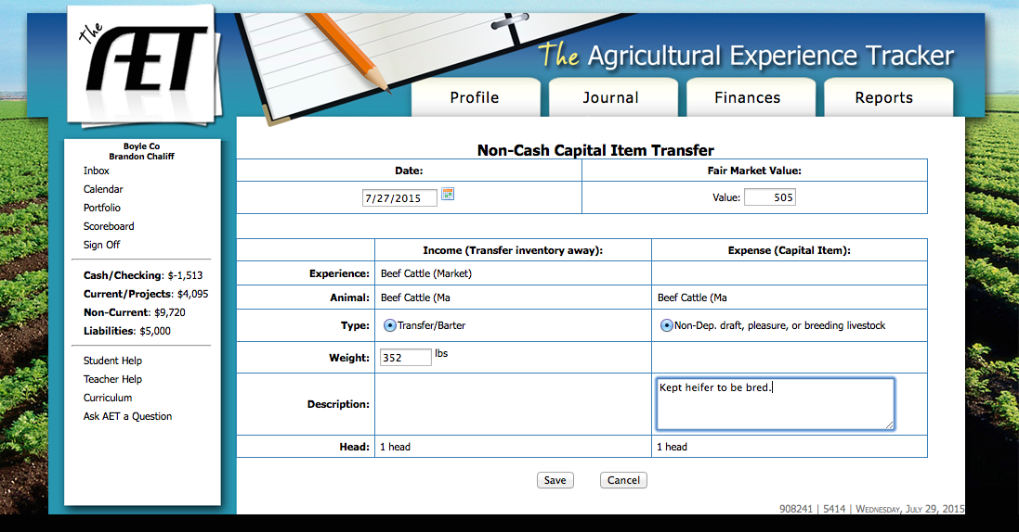
When managing our heifer, selecting “Transfer to Capital” from the drop down box will bring us to this page. Once again, we enter the fair market value of the animal, the weight at the time of the transfer, and a description of how we managed the animal. Click save!

Slide 16
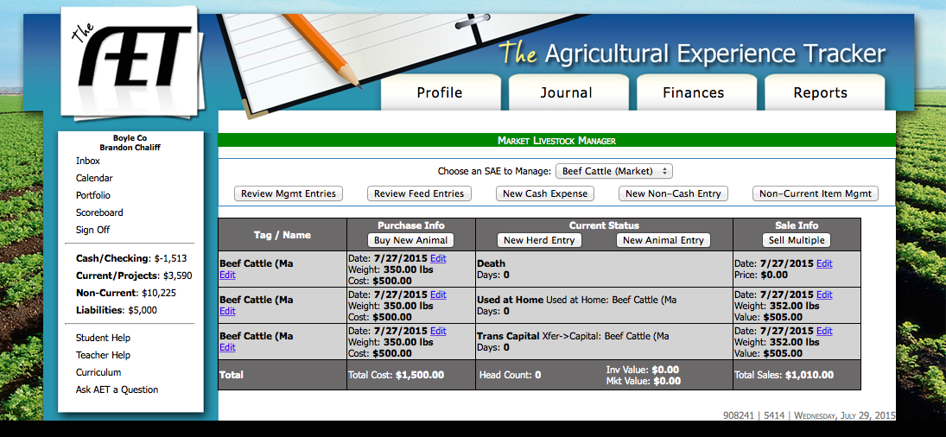
After making this changes, our Market Manager page should look like this.

Slide 17
Notice that we can also enter the Cash Expense, Non-Cash Entry, and Non-Current Item pages from the Market Livestock Manager page. These are the same pages that you can access from the Finances homepage.

Slide 18
This page also has a feature that allows you to review feed entries made in the cash expense page.

Slide 19
Next, let’s take a look at how we can use the Breeding Herd Manager feature.

Slide 20
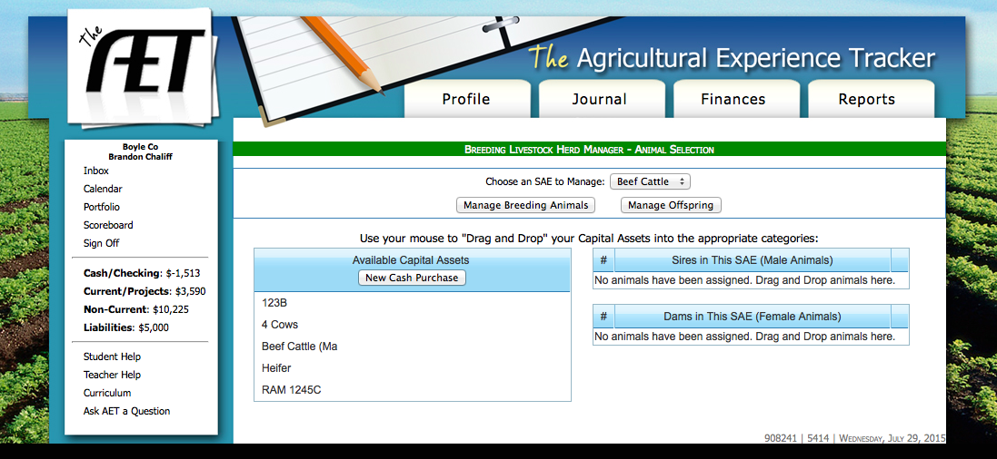
This is the Breeding Livestock Herd manager page of the AET. Notice that all animals entered from previous examples are listed under “Available Capital Assets”. We can also enter new purchases from this page.

Slide 21
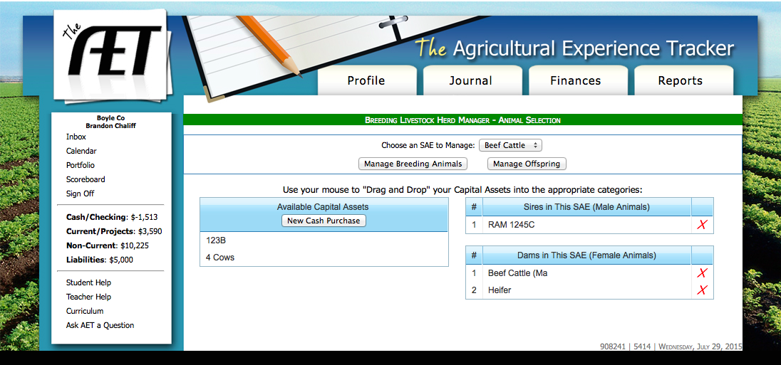
You can then “Drag and Drop” individual animals into the appropriate categories on the right hand side of the page.

Slide 22
You can then select “Manage Breeding Animals” to keep records on individual animals.

Slide 23
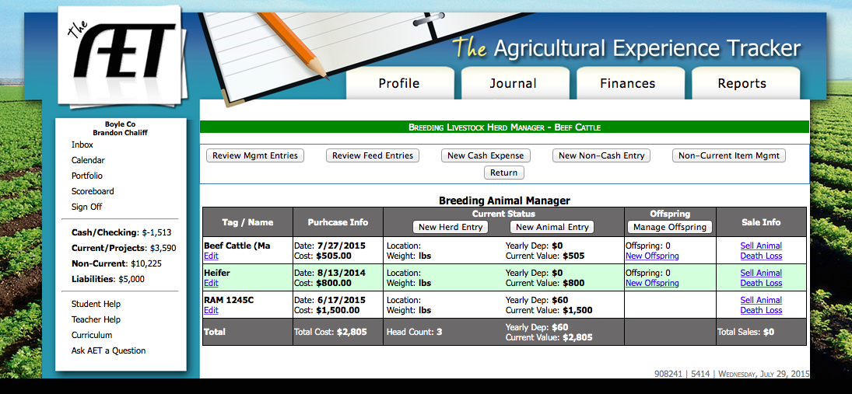
The “Manage Breeding Animals” tab is very similar to the “Manage Market Animals” page. However, on this page you can also manage off-spring and our only options for “Sale Info” are either selling the animal or death/loss.

Slide 24
Let’s say that “Heifer” has a calf.

Slide 25
In order to enter this information, we should select “New Offspring” on the appropriate line.

Slide 26
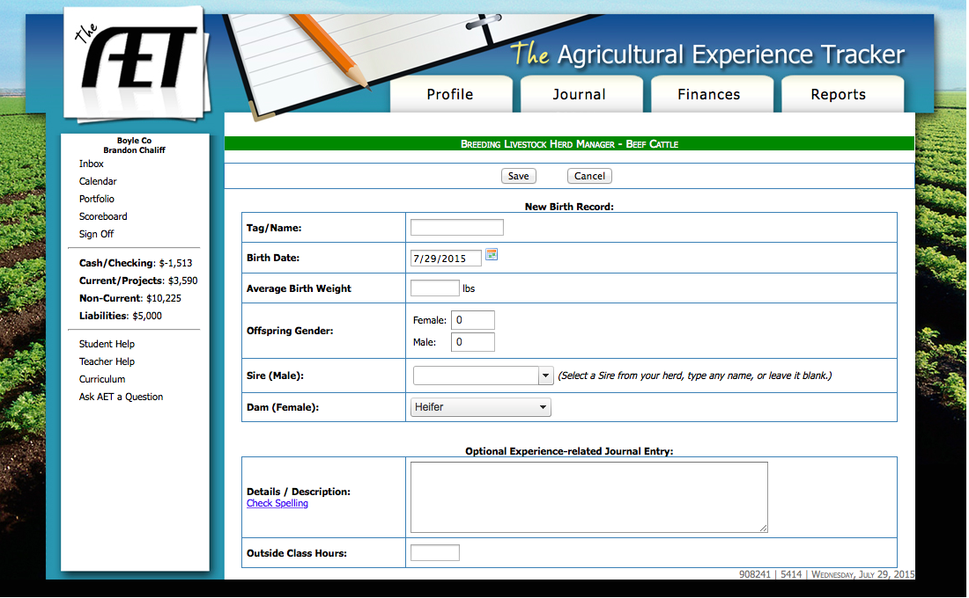
Selecting “New Offspring” will take you to this page. Here you can enter all the appropriate information about offspring from this heifer. After entering this information, you can then manage the offspring.

Slide 27
Side Note: As you can see, when keeping livestock records, it is critical to enter each animal on a different line and give it a separate designation if possible. This can be a name or a combination of numbers and letters. Keeping good livestock records hinges on being able to tell which animal is which on paper!

