Slide 1
Job shadowing at Hebron Animal Hospital
By: Melanie Palmer

Slide 2
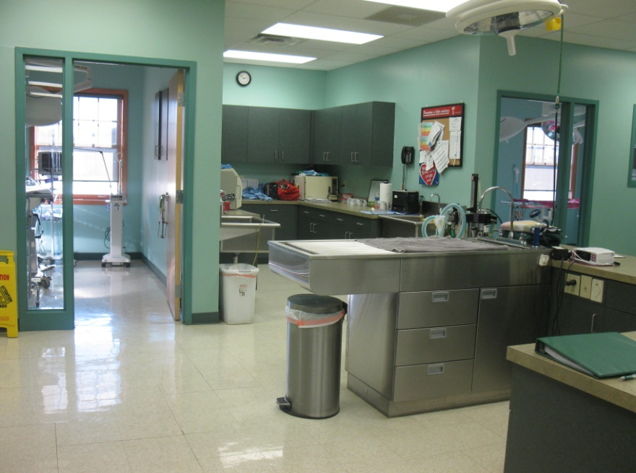
What’s Behind the Examining Room?
The picture to the right has:
Two examining tables
Boarding rooms for dogs and cats
And two rooms for animals that are recovering or waiting for surgery or other medical help
Recovery Rooms
Dogs
Cats
Major surgeries
sinks
The picture to the left depicts:
Sinks for the veterinarians to prepare for surgery
Two surgical rooms
Minor surgeries

Slide 3
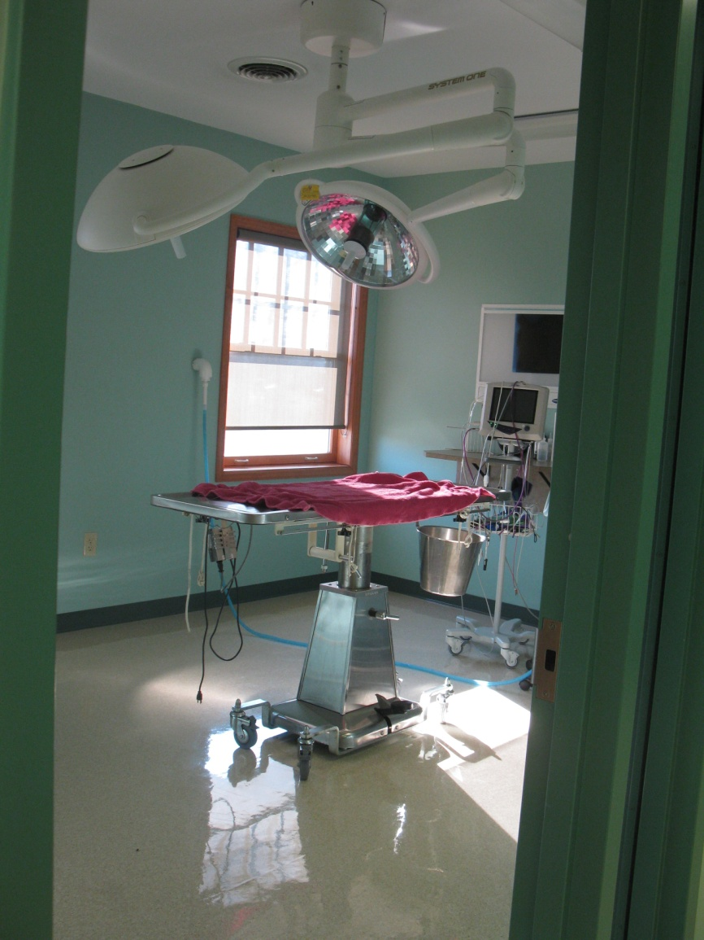
The Two Surgical Rooms
Minor Surgeries
Major Surgeries

Slide 4
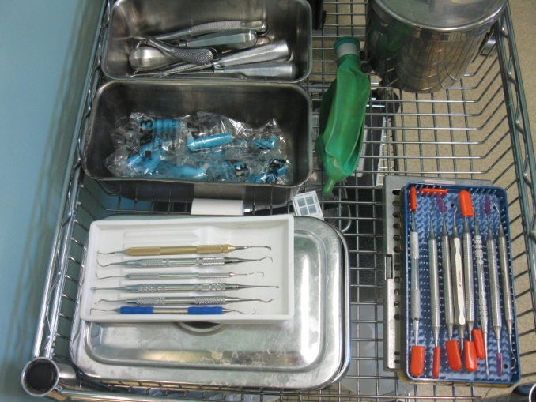
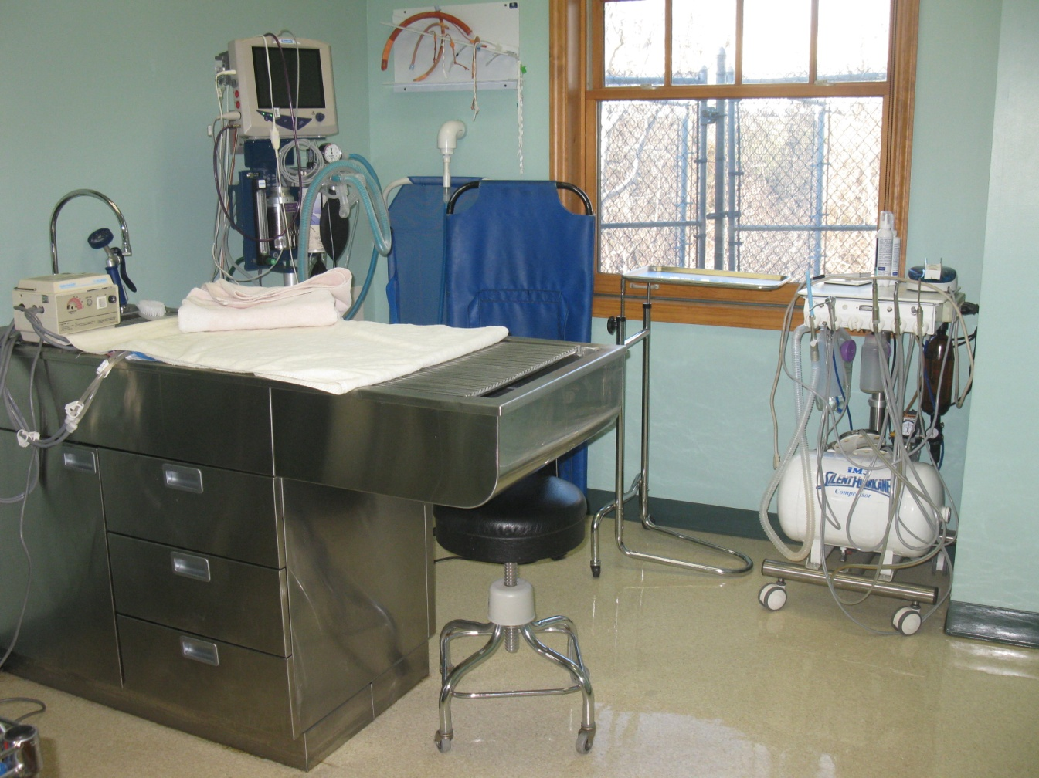
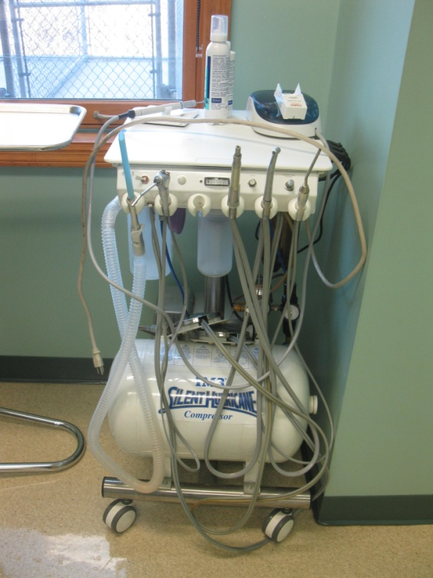
Dental Surgeries
Tools for the teeth
Vets will use this Dental Machine to clean dog’s teeth with ultrasonic scalers, or curettes.

Slide 5
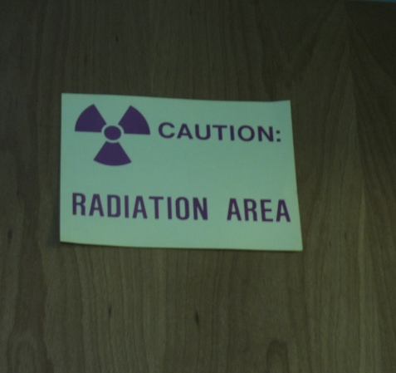
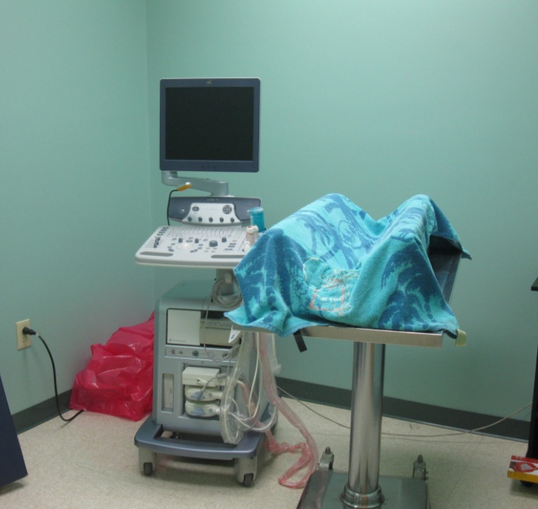
The X-Ray & Ultrasound Rooms
The picture to the right is the X-Ray room. The objects that are hanging on the wall are lead vests.
The room to the left is the ultrasound. The dog is lifted and placed belly side up on the blue blanket.

Slide 6
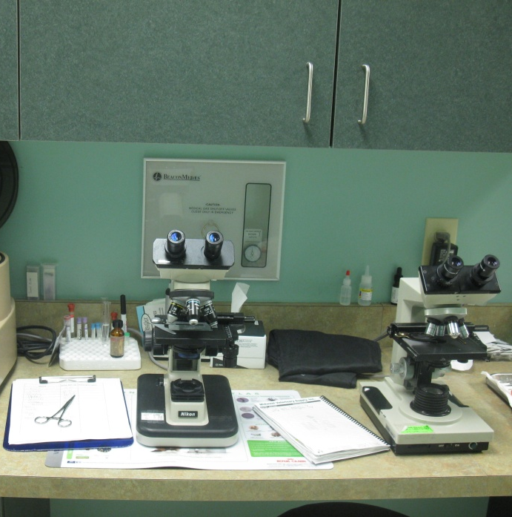
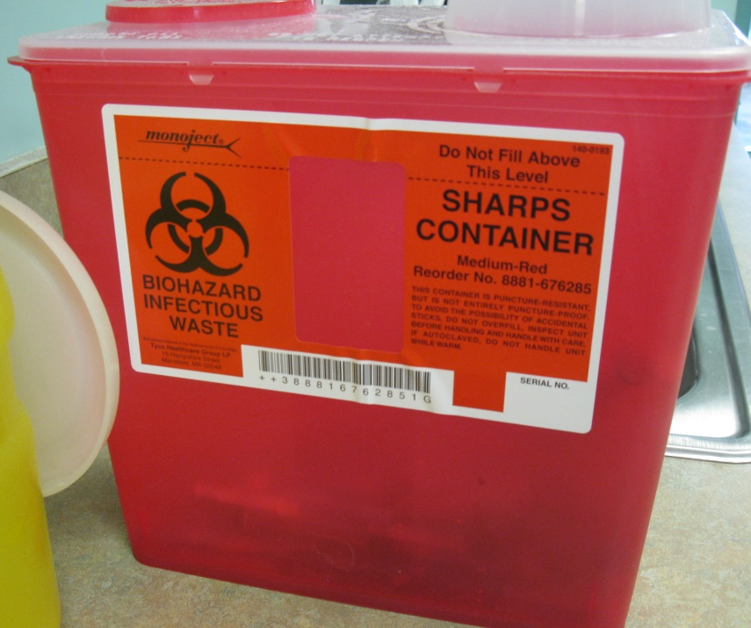
Biohazard!!
Here are some microscopes the vet-techs and vets use for urinalysis or looking at other samples to figure out what is causing the pet’s sickness.

Slide 7
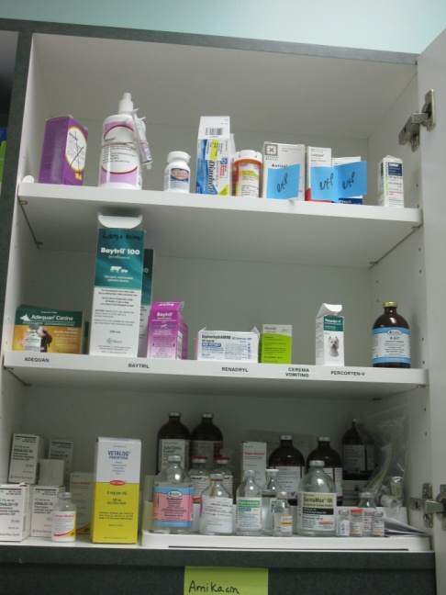
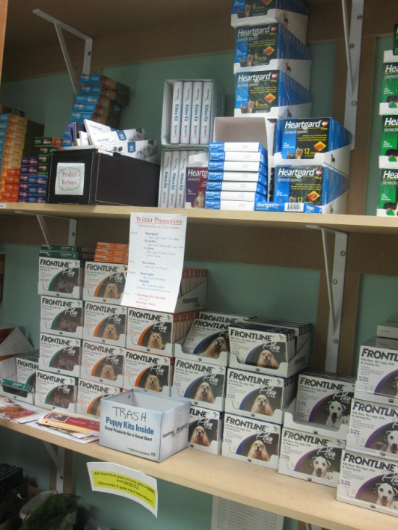
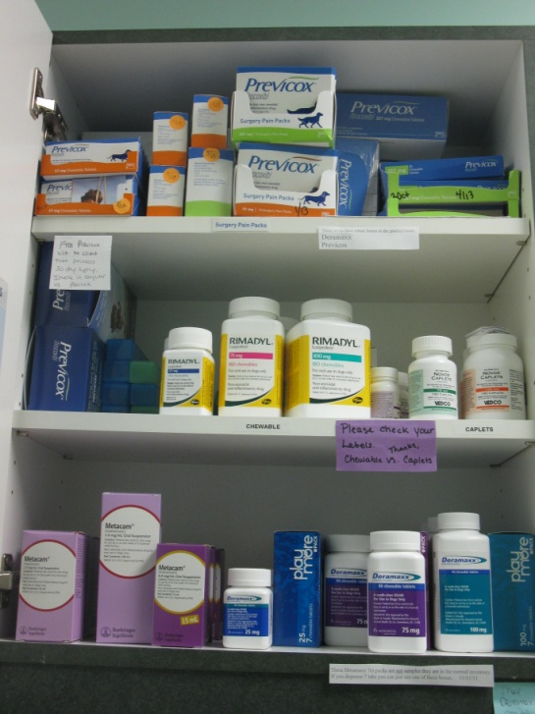
Inventory
Injections
Inventory of Frontline, veterinarian food, and hygiene products
Oral medication (caplets)

Slide 8
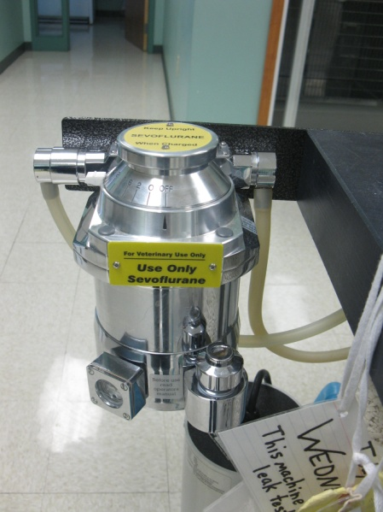
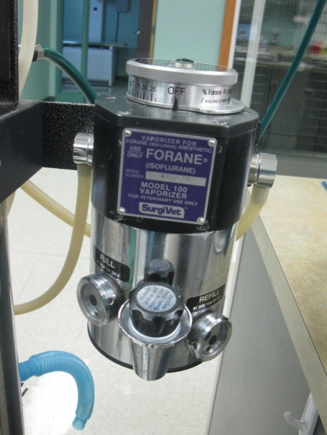
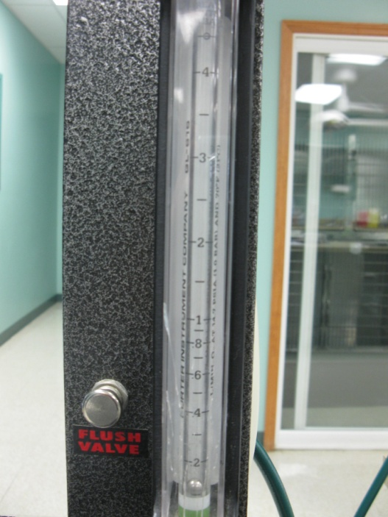
Sevoflurane inhalant anesthetic.
The animal will wake up quicker
It is used when an animal has kidney problems.
Isoflurane inhalant anesthetic.
More commonly used.
Veterinary Anesthesia Machine
Flush valve- provides a high flow of oxygen to the patient. 0.1 lpm or liters per minute.

Slide 9
Preparation Before Surgery
The vets start off using the Sevoflurane (the inhalant anesthesia) then switch over to the Isoflurane and wait until their eyes roll under. If their eyes are:
Up and dilated the animal is too deep in the anesthesia and can die.
Up and not dilated the animal is constricted.
The eyes need to be rolled under!

Slide 10
Preparation continued
They may give the animal penicillin to help make sure there’s no infection.
When putting the trachea tube in, if you move it too far up or too far to the right or left, you’ll get into the stomach.
The vets will shave the dog before surgery from the sternum down. Then they will disinfect the area with soapy cloths.

Slide 11
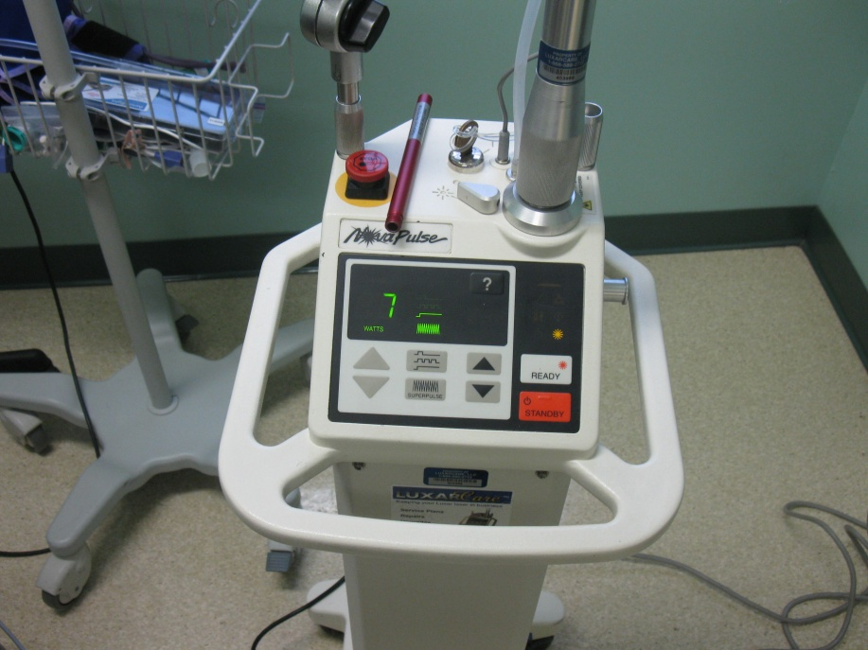
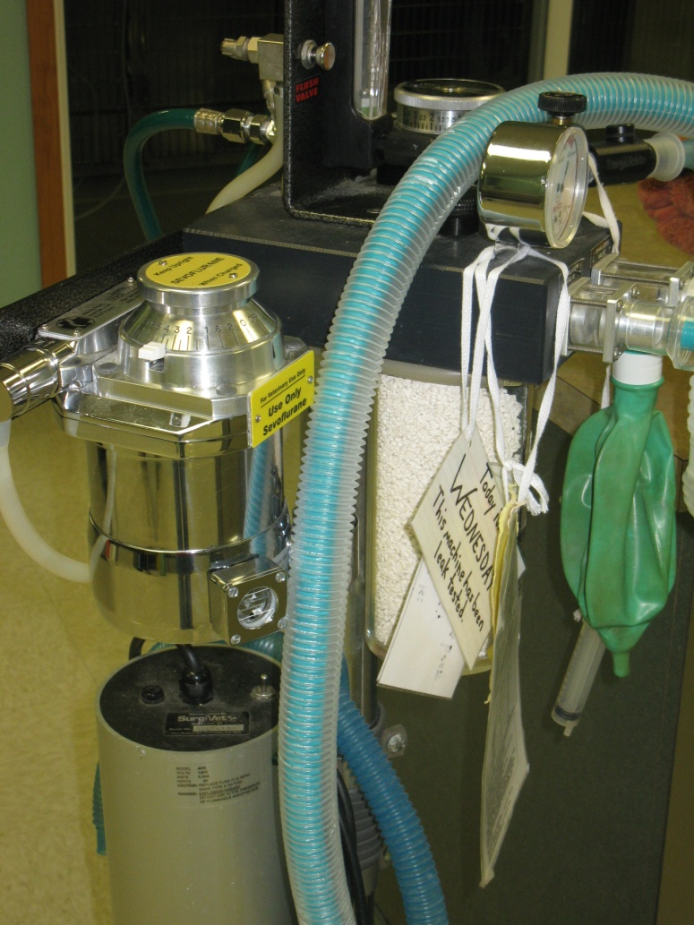
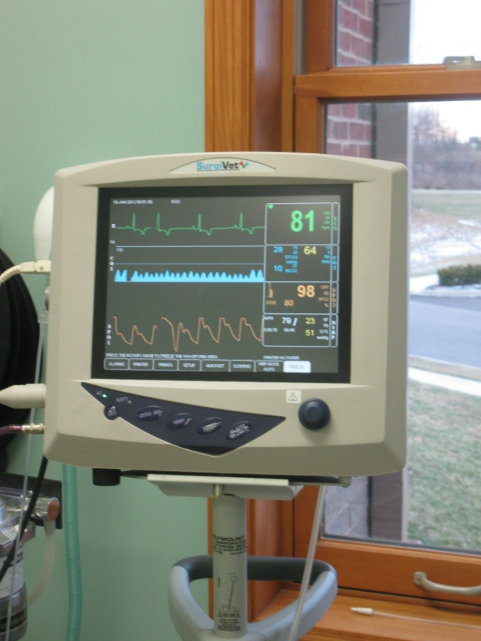
The picture to the left depicting a surgical laser machine. The number indicates the power of the incision.
To the right is a vital sign monitor.
Green #- heart rate
Blue #- carbon dioxide/breathing per minute
Orange#- blood/oxygenation
White #- blood pressure
The little white rocks indicate whether or not the anesthesia is still effective. If they aren’t that effective the stones will turn purple.

Slide 12
Surgery!
These next pictures can be a bit disturbing for
anyone who has a weak stomach. These are
pretty clear pictures of a dog being spayed.

Slide 13
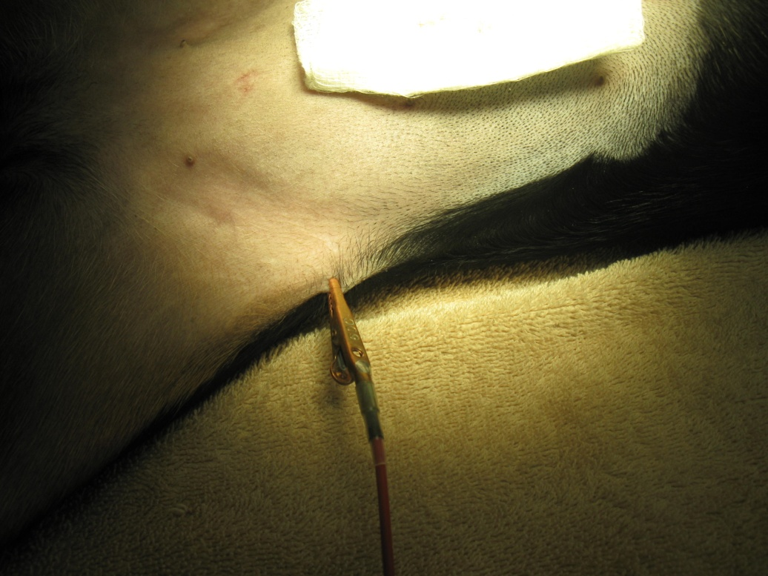
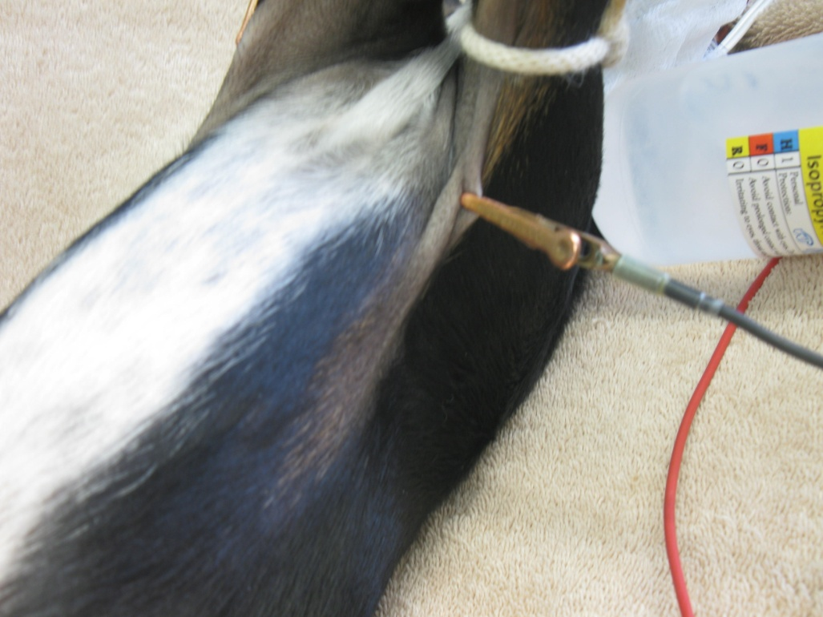
The wire hooked up to the dog is to find the dog’s pulse. They are hooked up to the vital sign monitor and is the green number, or heart rate.

Slide 14
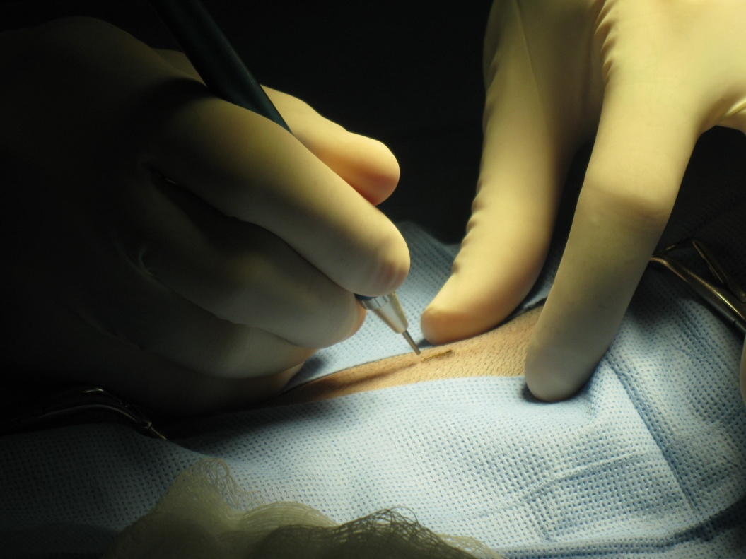
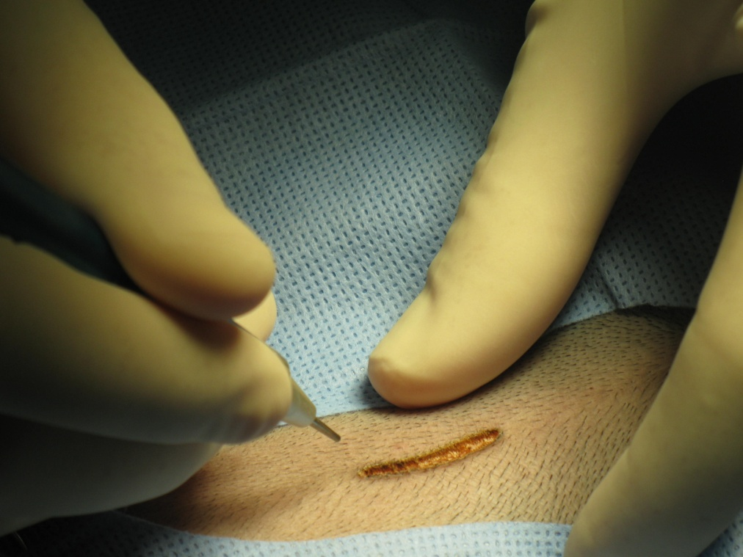
Incision with Laser
The power of the laser is probably between a 5-7 to make an incision in the skin.

Slide 15
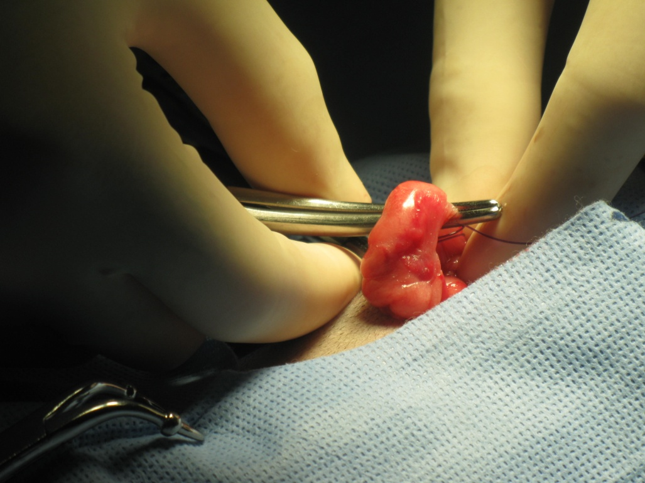
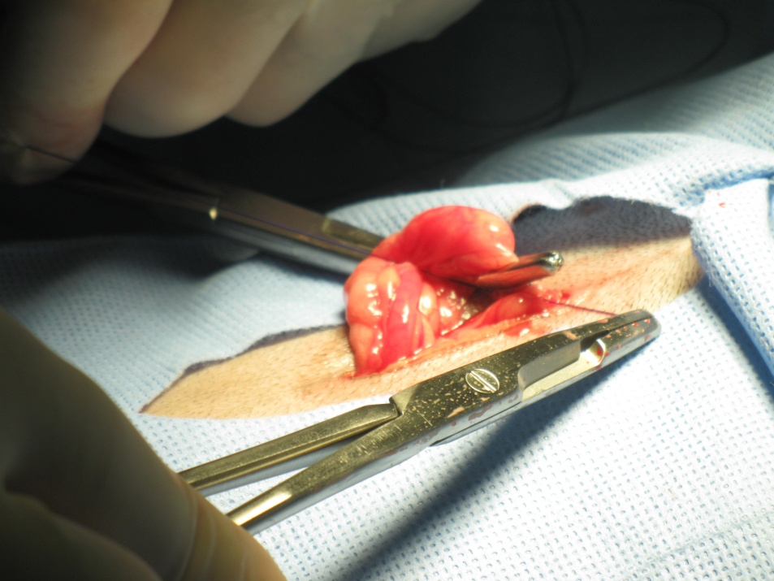
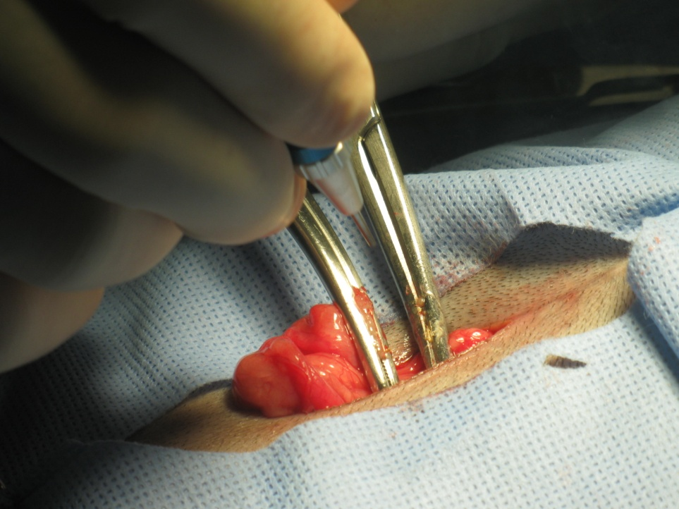
Cutting Off an Artery to Uterus

Slide 16
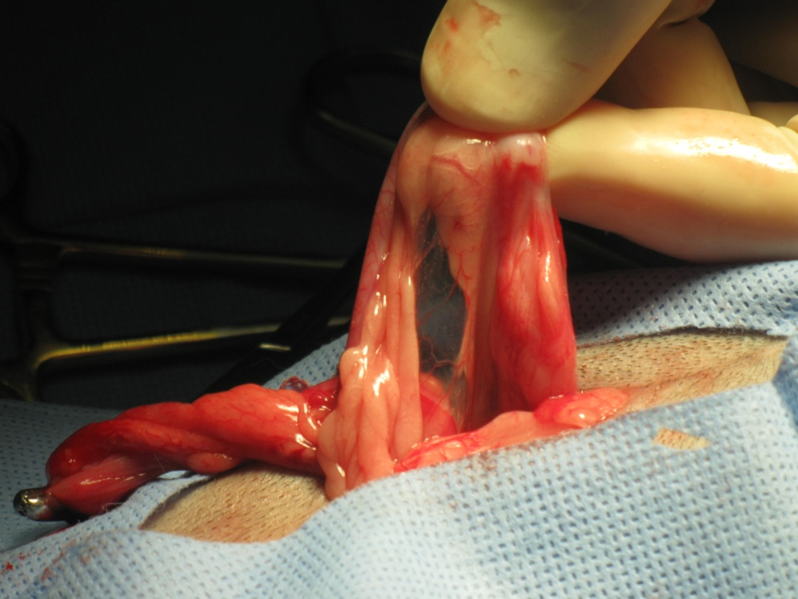
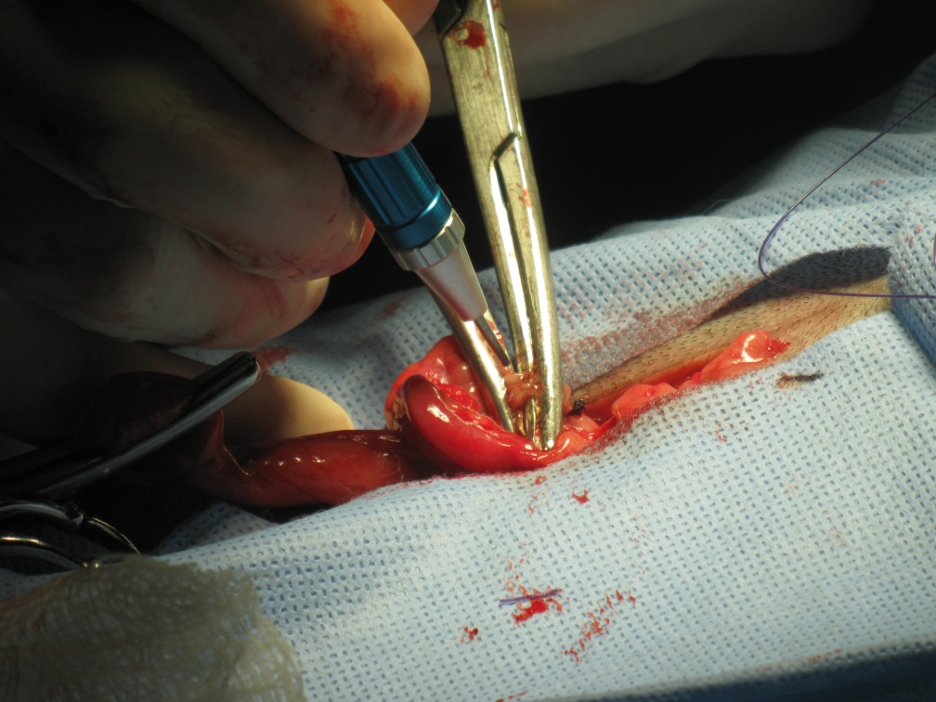
The Uterus and Ovaries

Slide 17
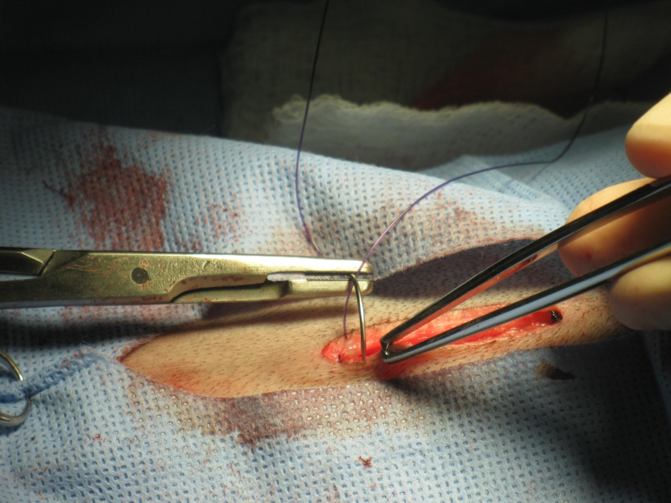
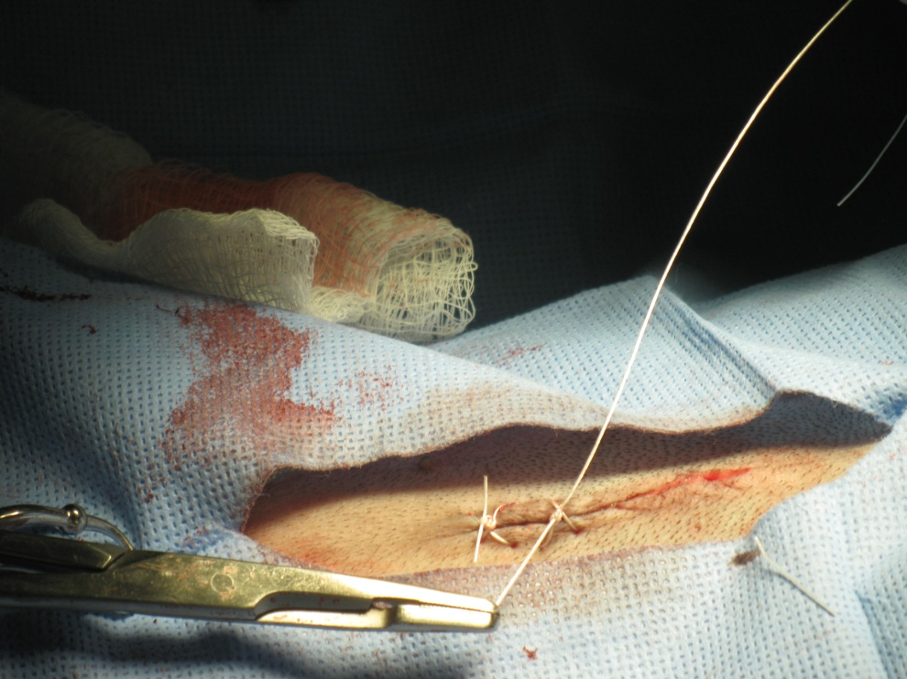
Closing up
Far side, near side, far side , near side….
Fat layer
Abdominal layer, above the muscle, known as fascia.
Skin, tying knots

Slide 18
TA DA!! End of Surgery

Slide 19
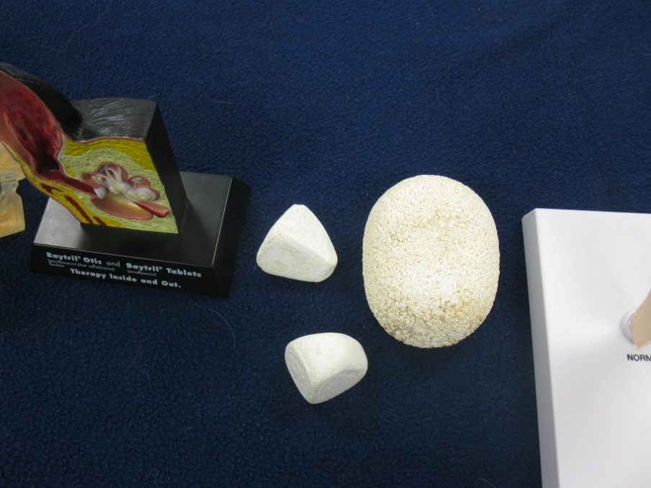
Some Models and Real Bladder stones
Normal
Moderate
Knees
Early
Advanced
Bladder stones

Slide 20
Other Animals That I Saw
The first day there was a boxer on seizure watch.
There was a cat with kidney failure.
A little white dog and an older medium sized, fat, white dog that got spayed.
A black barn cat that had some sort of disease and wasn’t doing that well. He was under careful watch.

Slide 21
Other Animals continued
A white and grey female cat about 11 yrs old that needed to get bladder stones out of her bladder.
Then one of the vet-techs brought in her two ferrets because one of them had some type of cancer.
A puppy with Parvo.
A Chihuahua that needed to find a home.
A dog that needed surgery on its eye because it got in a fight with another dog over a bone. It also had a puncture wound in it neck.

Slide 22
Some Things I Learned
The MSDS’s, that we talked about in the beginning of the year, are on all of the computers.
When my dog, Lule (means flower), accidently ate rat poison we brought her in to get her blood taken. Instead of the vet-techs taking the blood in the arm, like we practiced, they took her blood in the neck. The reason:
dogs have less nerves in their neck, unlike us, so it won’t hurt as much in the neck. It will hurt in the leg more since there are more nerves.
There is also a larger quantity of blood in the neck
The animal may bite

Slide 23
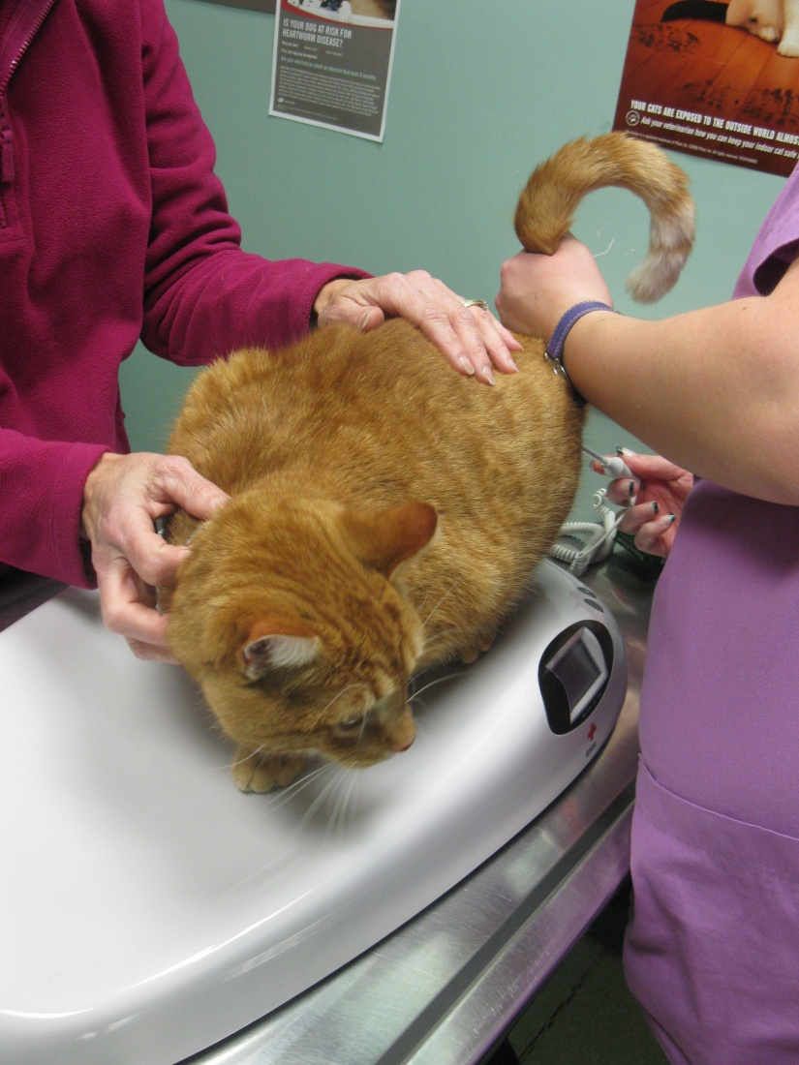
Check up for Tiger! ☺
Weighing Tiger
Checking Tiger for worms

Slide 24
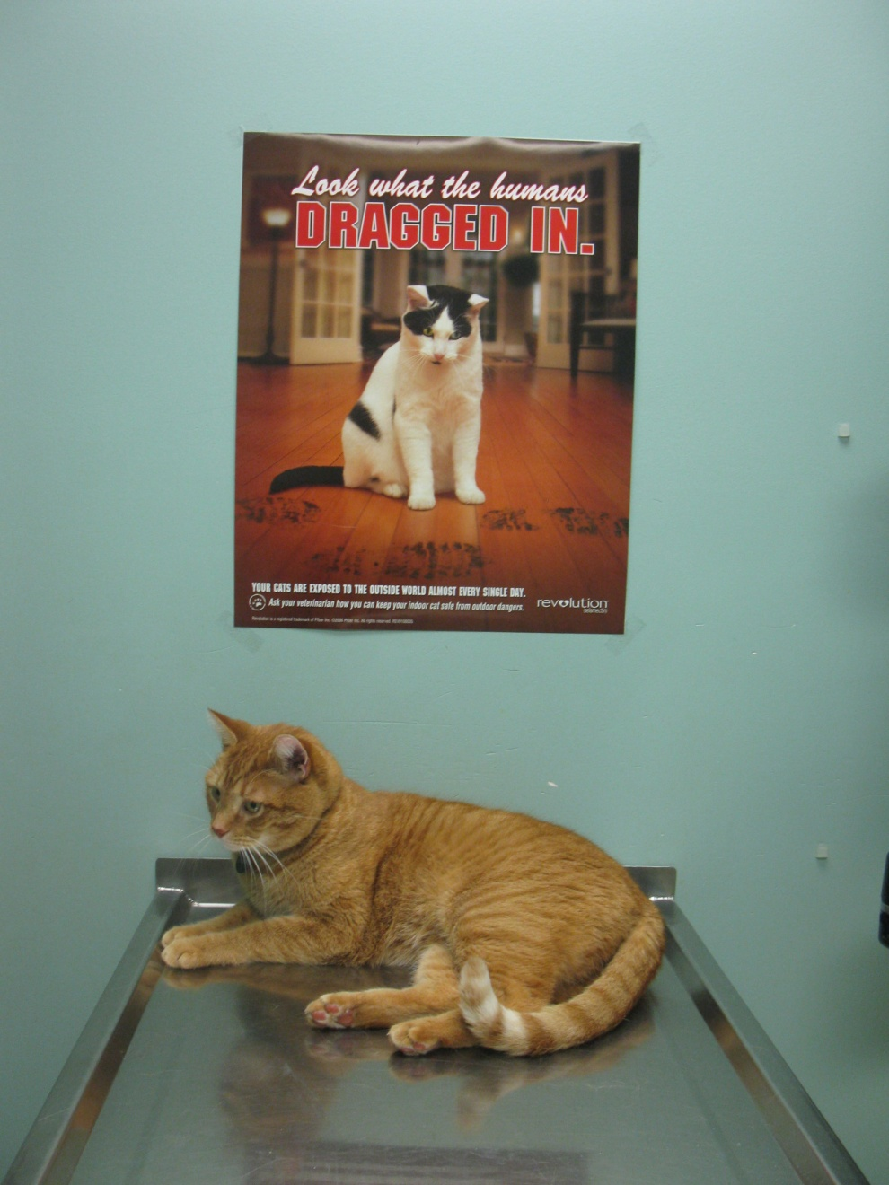
Tiger is waiting and resting

Slide 25
Putting pills in ☹
Pill

Slide 26
Petting Tiger

Slide 27
THE END

