Slide 1
In My Own Backyard
SAE Project and Field Study on the Backyard Ecosystem
Hanna Shafer

Slide 2
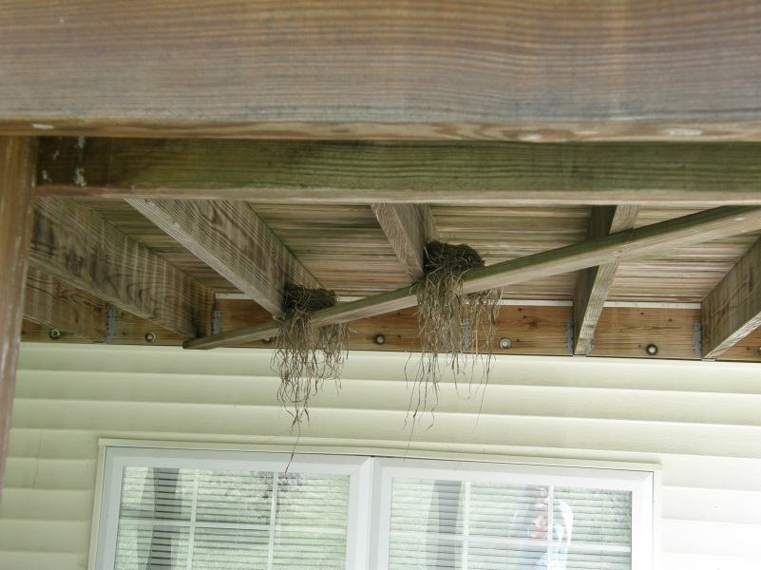
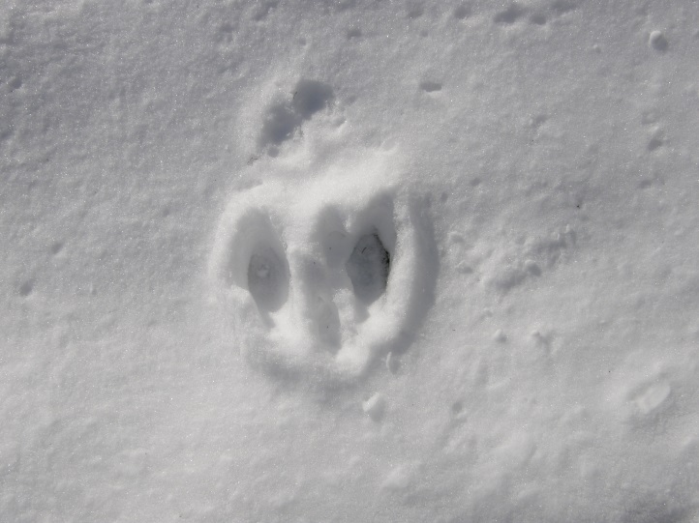
Goals
Learn more about different species
Be able to identify different species
Understand and interpret observations
Understand basic knowledge of a field biologist
Understand and observe the changes over time

Slide 3
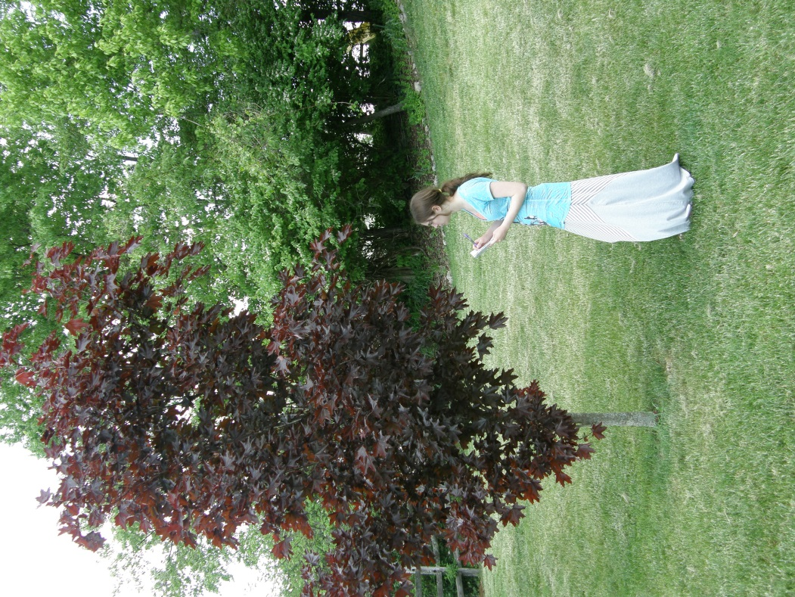
Project Description: Starting Out
Planning: Oct. – Dec.
Decided on area of observation
Focused on fieldwork basics
Identification
Observation
Research
Analysis (end of year)
Began fieldwork in January

Slide 4
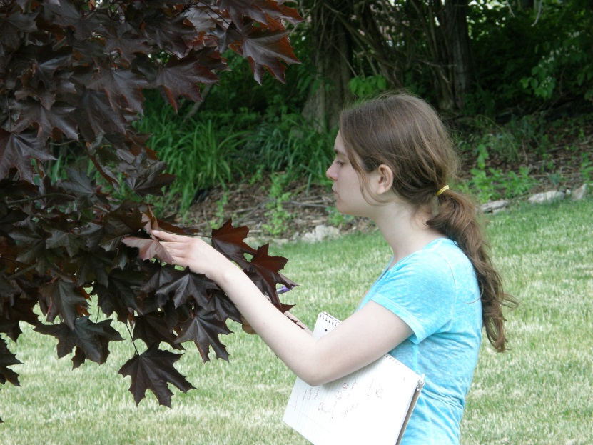
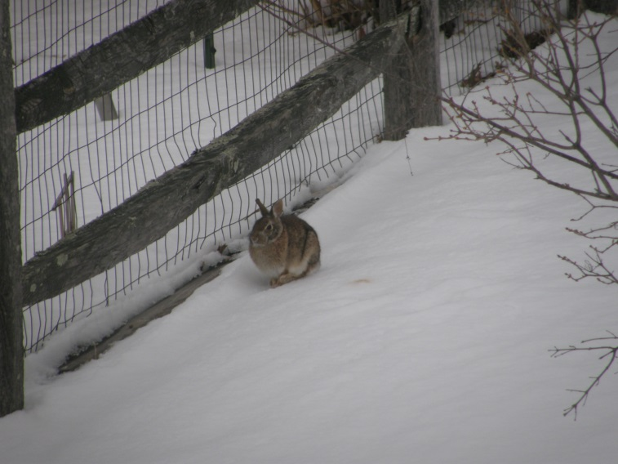
Project Description: Methodology
Materials:
Binoculars
Camera
Notebook
Computer/Tablet
Plant and insect species guide
Cornell Lab of Ornithology Website
Observed animals around 12 – 5 PM
Recorded observations with photos and notes
Identified species after observing them
Researched species after identifying them

Slide 5
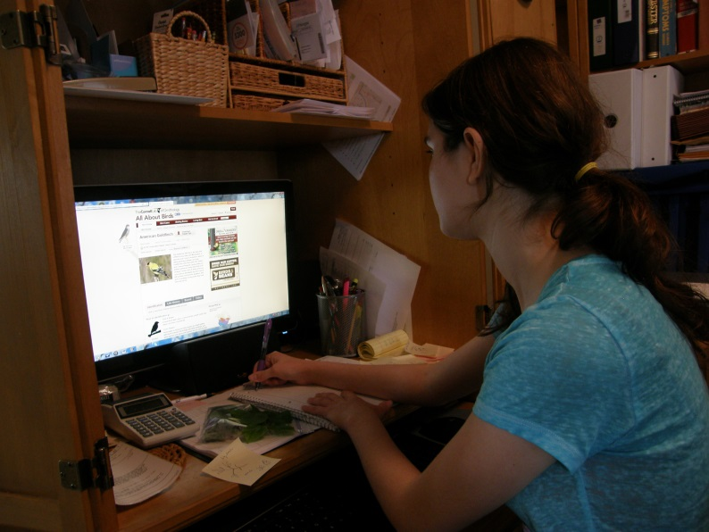
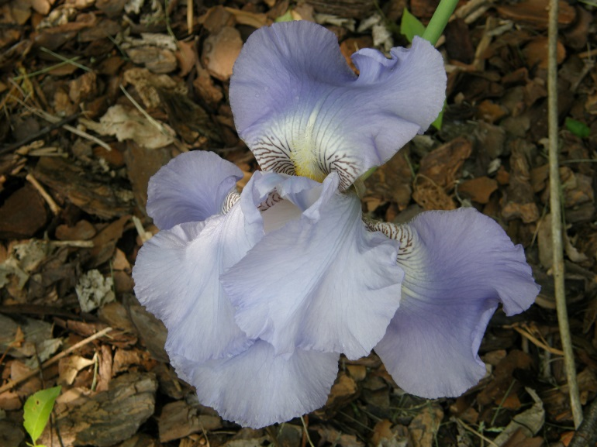
Project Description: Finalization
Analysis
End of April and beginning of May
Analyzed notes and photos

Slide 6
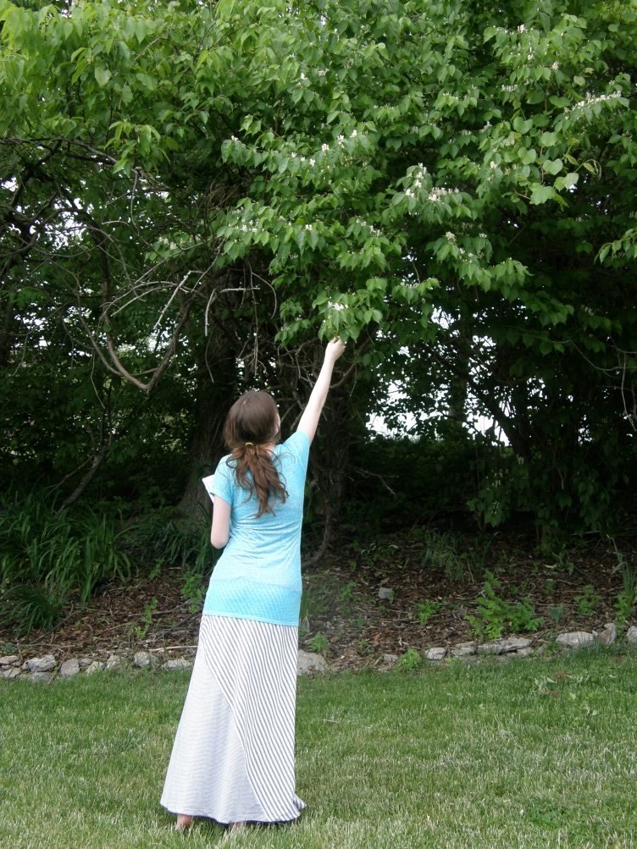
Investments
Time:
Ongoing project throughout the year
Dec. 1st to April 28th
Submitted 32 AET entries
24 hours recorded on AET
May have been more
Supplies/ Money:
I already had most of my supplies
Mrs. Averett allowed me to use her plant and insect field guide

Slide 7
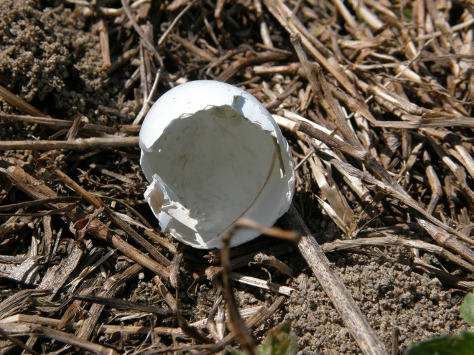
Project Outcomes: Animals Identified
27 birds
5 mammals
No amphibians
No reptiles
No fish
13 insects
29 plants

Slide 8
Project Outcomes
Plant life:
Exponential growth in March and April
Animal Life:
Mammals appeared mainly in January and March
Birds were always present
Exceptions:
Dark-eyed Juncos
Blue Jays
Gold Finch
Great Horned Owl
Mallard Ducks
Canadian Geese

Slide 9
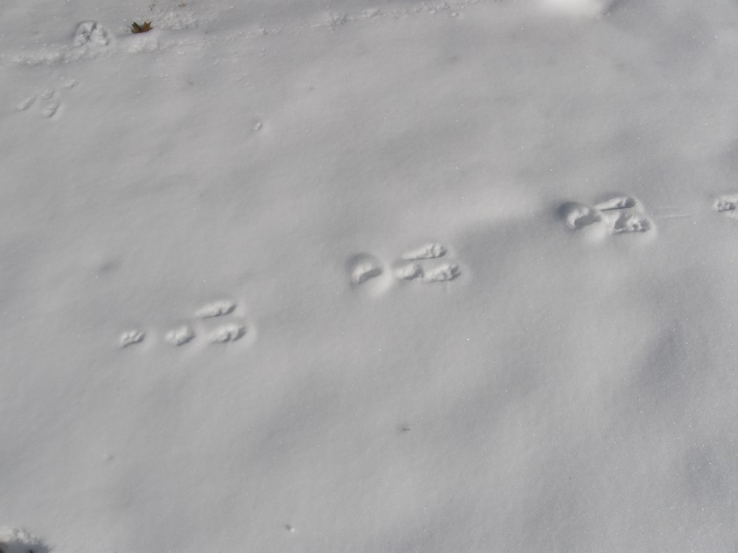
Project Outcomes
Understanding of wildlife
Understanding of growth/migration seasons
Understanding of fieldwork techniques
Gained knowledge on specific organisms
Gained skills in identifying species

Slide 10
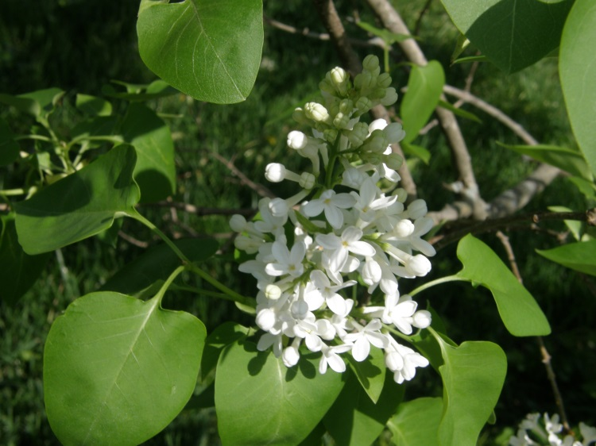
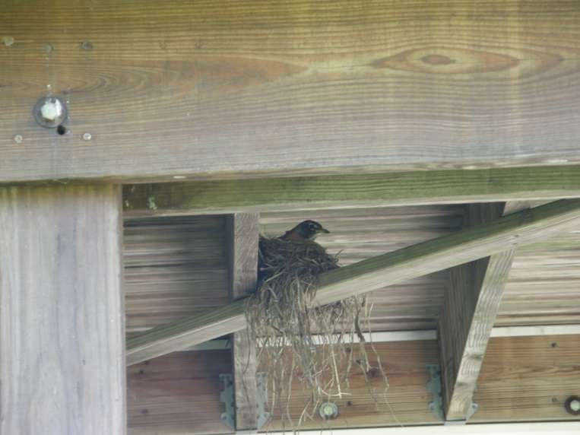
Conclusion: What I have Learned
Fieldwork takes patience and time
Identification can be difficult
Record observations vividly
Smaller populations are easier to observe
Focus on one species
Qualitative and quantitative data

Slide 11
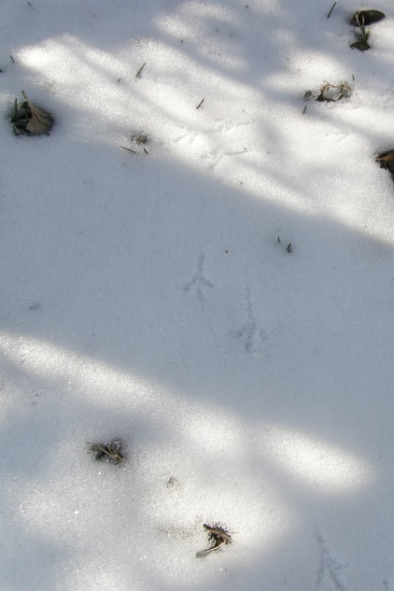
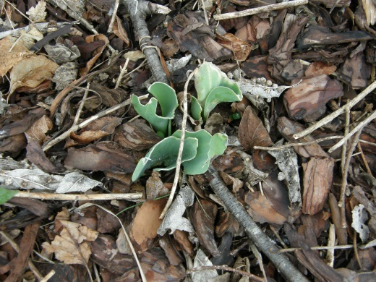
Conclusion: What I have Learned
The importance of each individual
How organisms work together
How animals interact with each other
Common behaviors
Timing for certain biological events
Interesting info on plant values

Slide 12
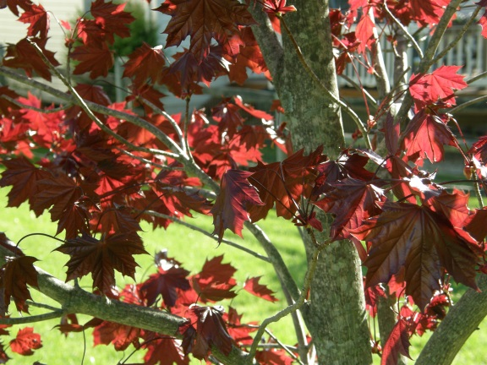
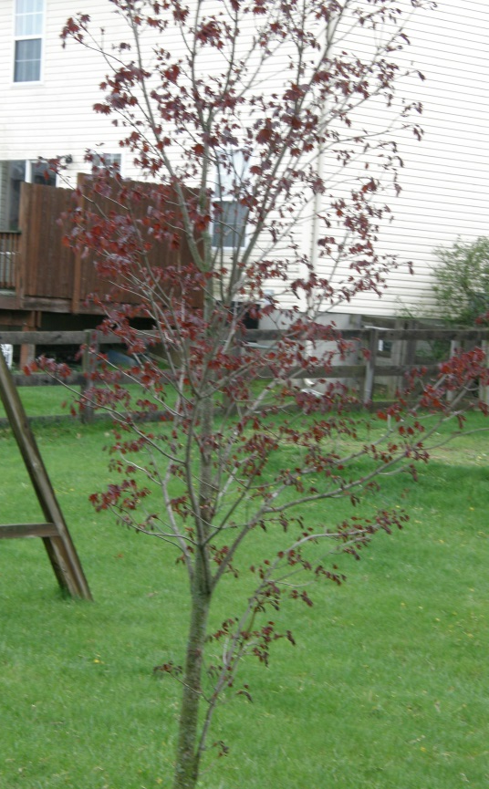
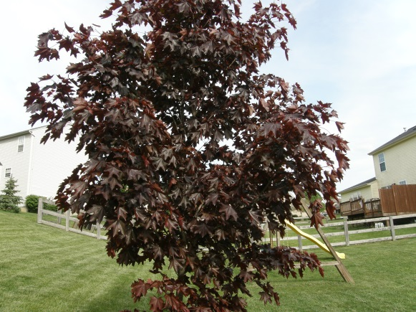
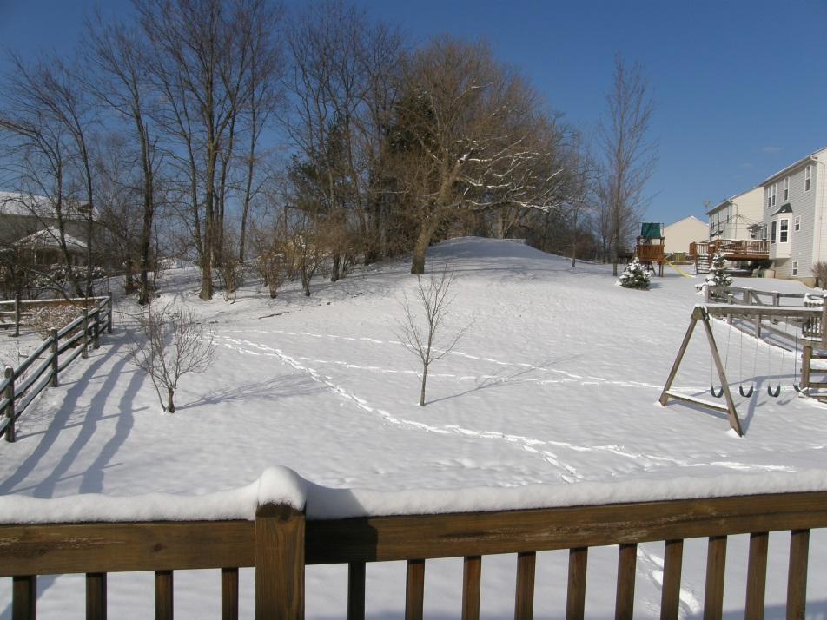
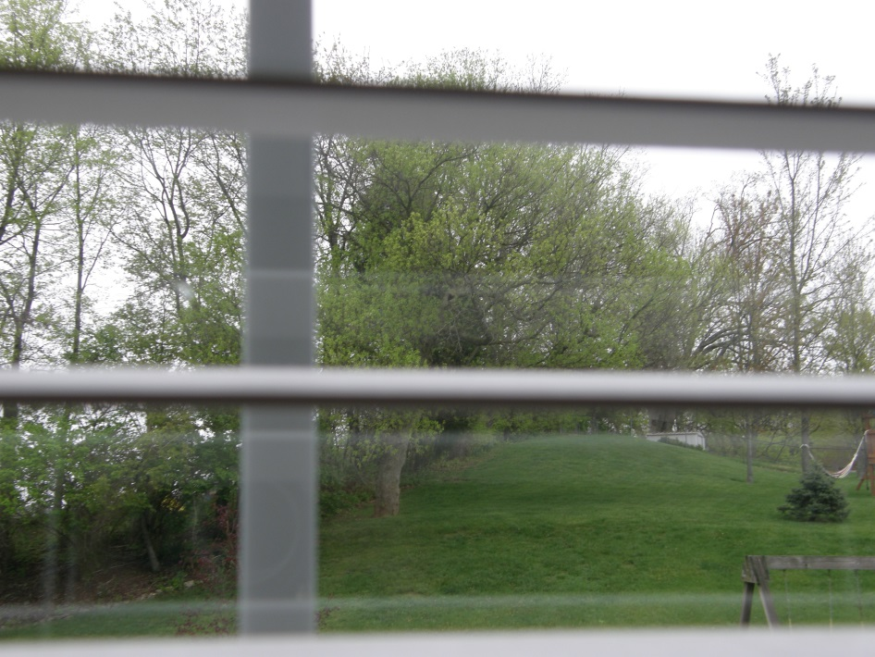

Slide 13
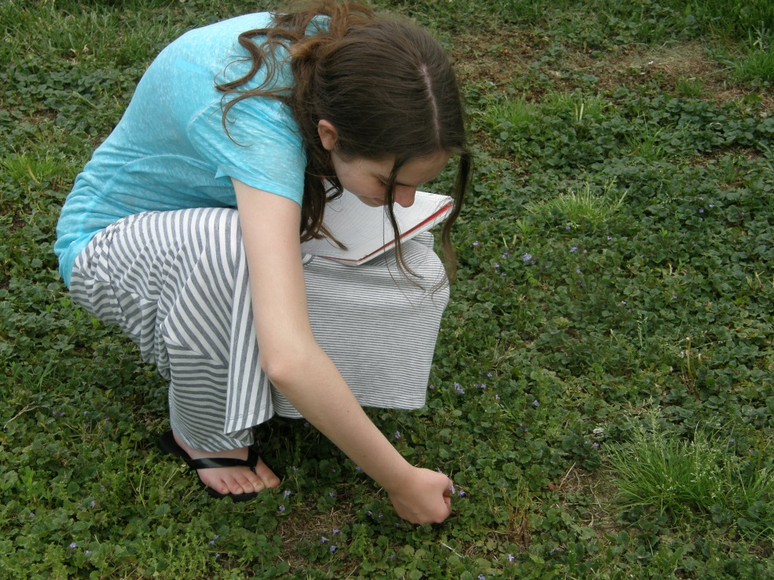
Conclusion: Career Goals
Field Biologist/ Wildlife Biologist
Discovered insights on performance of duties
Found mistakes to correct
Science Education
Found way to learn/communicate important details in
Natural Science
Biology
Wildlife Conservation
Ecology

